Slide 1
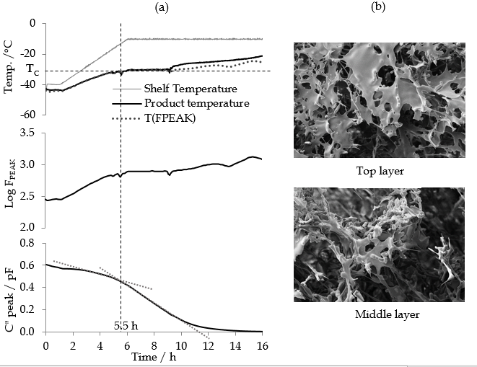
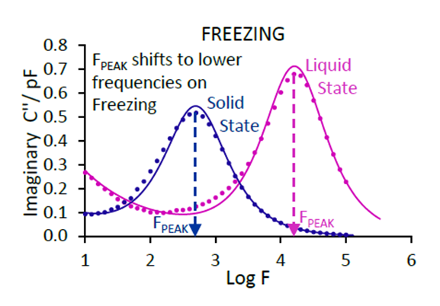
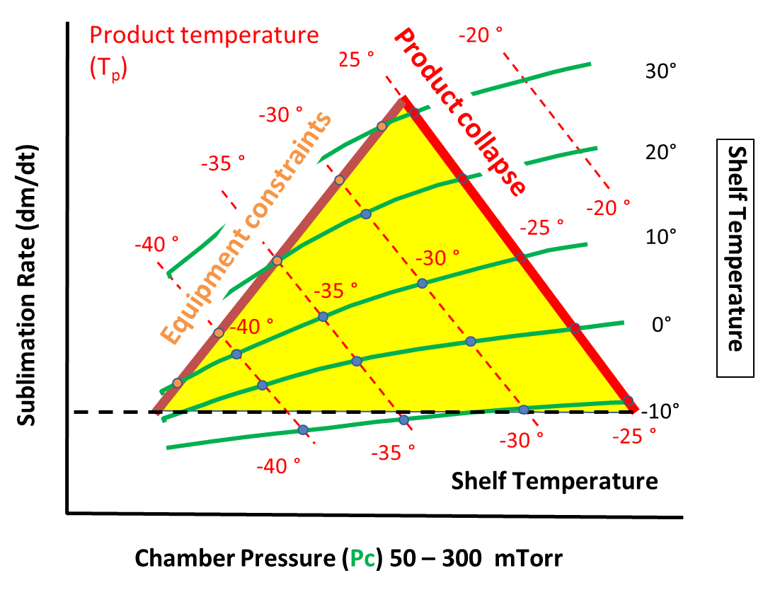
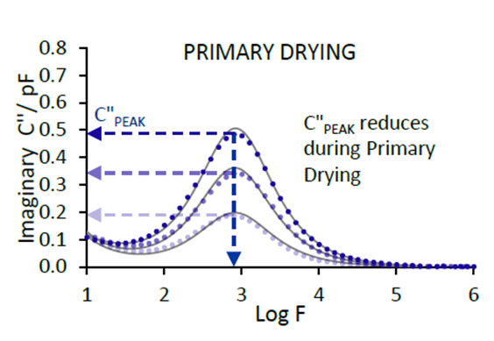
A Novel Process Analytical Technology (TVIS) for the Prediction of Micro-Collapse
during a Freeze-Drying Process Yowwares Jeeraruangrattana, Bhaskar Pandya, Harriet Vhokiwa, Shrinath Shah, Geoff Smith
Pharmaceutical Technologies, School of Pharmacy, De Montfort University, Leicester LE1 9BH
INTRODCTION During the primary drying stage of a freeze-drying cycle, an increase in product temperature above the glass transition temperature of the freeze concentrated solution, Tg’, may cause the collapse of a freeze-dried cake (at a temperature known as the collapse temperature, Tc) with the possible rejection of the entire production batch. Consequently, the product is usually dried at a low temperature but at the expense of a more prolonged drying time. To achieve a cost-efficient cycle, with acceptable product quality, then the process should be designed with due consideration to this critical temperature.
QbD and the DESIGN SPACE
THE AIM is to evaluate the application of through vial impedance spectroscopy (TVIS) system for the prediction of micro-collapse during a freeze-drying cycle.
TVIS – Theory Two parameters, C"_{PEAK} and F_{PEAK} of the imaginary capacitance spectra of the TVIS vial (Fig.2) are considered to be invaluable in the assessment of a range of critical process parameters.
Fig.2 Imaginary capacitance spectra of the TVIS vial which demonstrates the principle changes in the dielectric loss peak during the freezing and drying stages of the cycle
F_{PEAK} may be used to predict the product temperature and for determining phase behaviour (ice formation, eutectic formation and glass transition events) in situ, whereas C"_{PEAK} can be used to determine the amount of ice remaining during the primary drying phase from which one can then predict both drying rate and end point (Smith et al. 2013).
HYPOTHESIS By combining an assessment of the drying rate with the predicted product temperature it might be possible to first witness the micro-collapse event while at the same time confirming the accuracy of the temperature prediction.
METHOD The electrical impedance of a 5%w/v lactose solution contained within modified glass freeze-drying vial was measured over the frequency range of 10 Hz to 1 MHz during an entire freeze-drying process. A critical feature of the drying cycle is the inclusion of a ramp in the shelf temperature during primary drying that will force the product through its collapse event.
RESULTS & DISCUSSION The correlation between Log F_{PEAK} from the TVIS vial and the thermocouple temperature in a neighbouring vial (Fig.?) provides an opportunity to calibrate the TVIS response to give a predictive temperature known as T-FPEAK.
Fig. 3 Temperature calibration for log FPEAK
The premise for the prediction of the collapse event is the assumption that the calibration for the product temperature in the TVIS vial (as determined during the re-heating phase of the annealing stage) holds true during the primary drying stage, when the height of the ice layer in contact with the glass wall decreases progressively due to sublimation.
At 5.5 h into primary drying there is a significant increase in the rate of change of Cʺ_{PEAK} which corresponds to an increase in drying rate as shown in Fig. 4a. This suggests there is a microscopic change in cake structure, due to micro-collapse, which results in an increase the pore size distribution in the freeze-dried matrix thereby decreasing the product resistance and consequently improving vapour flux. This suggestion is confirmed by cake morphology images of the middle layer by SEM as shown in Fig. 4(b). The predicted temperature at this point in time is equal to the collapse temperature (− 32 ºC).
Fig. 3 (a) The temperature and TVIS parameter profile of 5%w/v lactose solution during the primary drying stage (b) SEM of top and middle layer of lactose cake at the end of the cycle
CONCLUSION A significant decrease in CʺPEAK at the point of micro-collapse (as confirmed by SEM) highlights the potential for using TVIS for monitoring microscopic changes in the product resistance to vapour flow associated with the phenomenon of micro-collapse. This study also demonstrated a good correlation between TVIS data (Log FPEAK) and temperature of the frozen solution during the annealing stage of the cycle. By using a temperature calibration from the annealing stage it was possible to predict the onset of collapse
This study demonstrates the potential for TVIS to be used as a process control tool that would allow the cycle to be driven at the highest achievable temperature whilst avoiding collapse
G. Smith, E. Polygalov, M.S. Arshad, T. Page, J. Taylor, I. Ermolina, An impedance-based process analytical technology for monitoring the lyophilisation process, Int. J. Pharm. 449 (1–2) (2013) 72–83
Supervisor : Prof. G Smith
TVIS – Overview The TVIS system comprises a bespoke multichannel high precision impedance analyser which was connected to a TVIS measurement vial, which is a standard 10 mL.
freeze drying vial that has been modified with copper electrodes (19 x 10 mm) attached to the outside of the glass wall, thus making the measurement non-product invasive.

