Slide 1




Lyophilization Process Development for Biopharmaceuticals
Applications for eis PAT
eis
Electrical
Impedance
Spectroscopy
PAT
Process
Analytical
Technology
Prof. Geoff Smith
Friday 23rd October 2020
Notes:
Hello and welcome to my talk
My name is Geoff Smith from the School of Pharmacy, De Montfort University, Leicester
I have been working for approximately 10 years
(click) on the development of P.A.T. solutions for pharmaceutical freeze-drying
(click) with electrical impedance spectroscopy being my primary focus

Slide 2
Overview
Lyophilization
Benefits : Challenges
Design space solutions ……
Electrical Impedance Spectroscopy Process Analytical Technology
  Z-FDM
  Impedance-enabled
  freeze-drying microscopy
  TVIS
  Through-vial impedance spectroscopy
  Formulation development
Process development
Notes:
I will start the talk with a few slides on why we need to freeze-dry certain drugs
and what are the benefits and challenges
before addressing the main focus of my talk
(Click) Which is the development of design space solutions based on eisPAT
(click) The first is an impedance-enabled freeze-drying microscope called Z-FDM
Which can be used for formulation development
(click) The second is through-vial impedance spectroscopy (or TVIS)
which uses the product container to support the electrode system
and can be used for process development

Slide 3
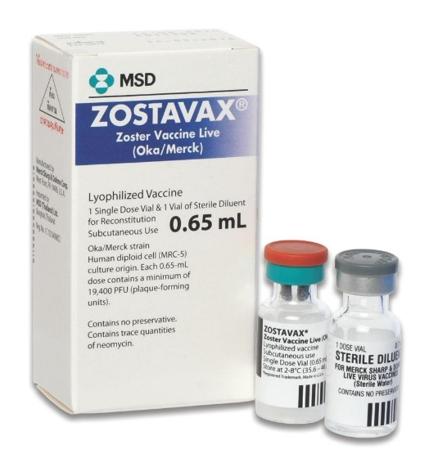
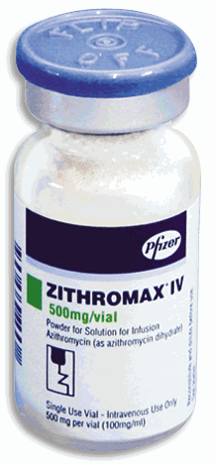
Benefits of Lyophilization
“40% of biologically based products have to be freeze dried”
“80% of the available products lyophilized in vial”
Lyophilization commonly used for
  Small Molecules Drugs (e.g. penicillin)
  Large Molecule Drugs (e.g. proteins, DNA)
  Microorganisms (e.g. bacteria, virusus)
  Blood products
Azithromycin
injection.
(Zithromax®)
Zoster vaccine
(Zostavax®)
Lyophilization
Freezing
Sublimation
Desorption
Powder
Easy to transport
Low moisture content
Increased Stability
More surface area & porous
Easy to Dissolve
Notes:
It is interesting to note how widely freeze-drying is used
across the biopharmaceutical industry
with approximately 40% of biological products requiring freeze-drying
for shelf-life purposes
And with the vast majority of these products being lyophilised in glass vials
which are then easy to transport
(Click) The process converts the liquid water to ice by freezing
then removes that by sublimation (at low temperature under a vacuum)
and finally heats the product to desorb a large proportion of moisture in the solid
(click) What results is a powder with low moisture content
and a high porosity that helps the solid to dissolve quickly
on reconstitution with water

Slide 4
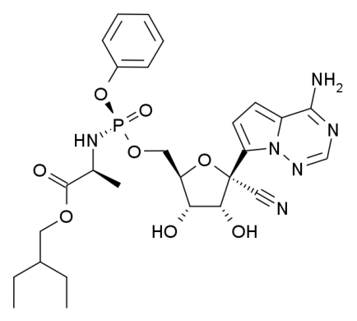
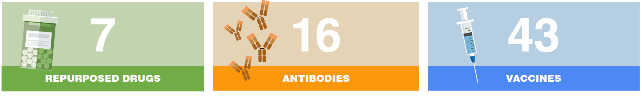

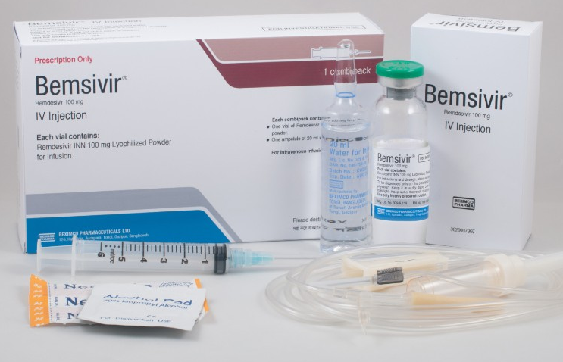
Applications (in the news) …… Remdesivir
Developed for Ebola (2008)
Re-purposed experimental drug treatment for Covid-19
co-formulated with cyclodextrin for solubility
& freeze-dried
Covid 19 therapies and vaccines
Notes:
A freeze-dried drug that has been in the news recently
is Remdesivir from Gilead Sciences
It is a nucleotide analog with broad-spectrum antiviral activity
that was originally developed for Ebola treatment
(Click) but is now being re-purposed
as an experimental drug treatment for Covid-19.
(click) An interesting feature of this product
is that the poor solubility of the API
was addressed by formulating with a cyclo-dextrin
which solubilises the hydrophobic part of the molecule
Allowing an aqueous solution to be freeze-dried

Slide 5
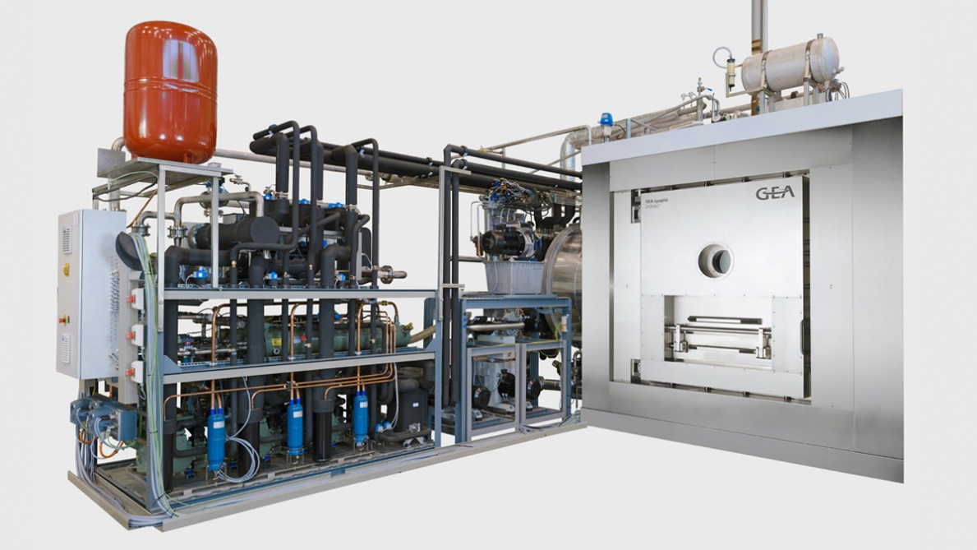
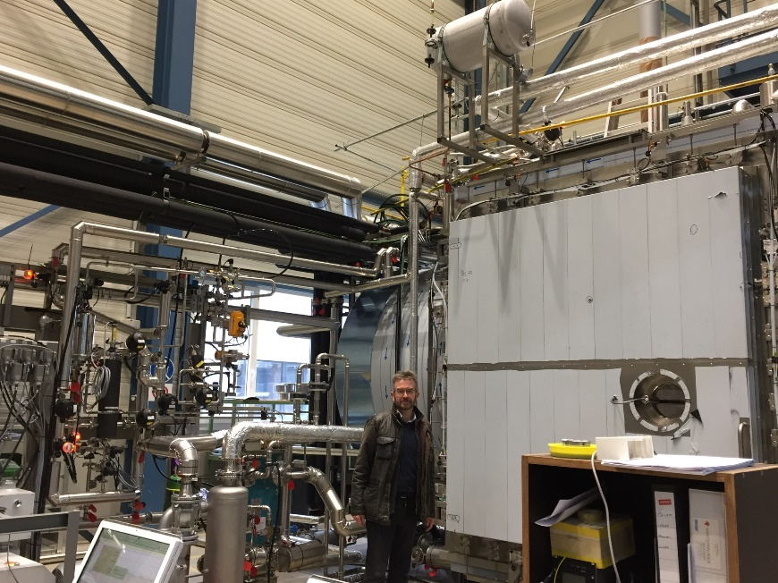
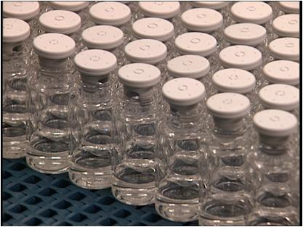
Challenges of Lyophilization
Complex 3 stage process
Cost: energy & GMP Long process (up to 5 days)
Difficult to scale-up
Variation within batch
Notes:
As with many things ……. There’s always a down side
These can be summarised,
(click) firstly in terms of the complex nature of the process in which the three stages of freezing, primary drying and secondary drying are intimately linked
(click) Secondly, in terms of the energy cost and GMP footprint whereby large volumes of drug product solution have to be first frozen before removing the ice at a low temperature in a long primary drying stage;
(click) Thirdly, in terms of the challenges of scale up as the physics of heat and mass transfer differs between scales;
(click) and finally in terms of the variation within a batch that results from the heterogeneity in the heat and mass transfer across the dryer.

Slide 6

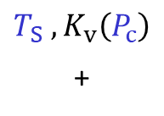
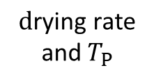


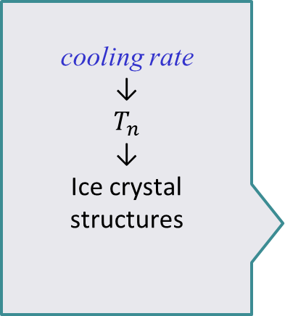

Complex design space
Formulation (Product Design)
Stability (chemical & physical)
  Packaging compatibility
$$Keep$$
$$T_{P}<T_{C}$$
  Critical product temperature $T_{c}$
Lyophilization (Process Design)
1° Drying
2° Drying
Freezing
Annealing
cooling rate
↓
$$T_{n}$$
↓
Ice crystal
structures
temperature
ramp
Shelf temperature $T_{S}$
& hold time
↓
$$\text{d}\text{rying} \text{rate}$$
and $T_{P}$
Maximize ice
crystal size
$$T_{P}$$
$T_{S}$ $, K_{v}\left(P_{c}\right)$
+
$$R_{p}$$
Final moisture
content
Process parameters
Notes:
We can see the complexity of the process when we consider the design space:
[click 1] where formulation choices must deliver
chemical and physical stability
and compatibility with the primary container, in both the liquid and solid states
[click 2] while being mindful of the impact of formulation on
the product-specific critical temperature known as the collapse temperature Tc)
[click 3] then there are the process parameters of each of the 4 stages of the process
[click 4] where cooling rates and ice nucleation temperatures
Impact ice-growth and therefore the resulting crystalline matrix
[click 5] AND where an optional annealing process
might be used to maximise ice crystal sizes [CLICK]
That ultimately define the dry-layer resistance-to-vapour-flow (R_{p})
[click 7] Then a combination of the dry layer resistance Rp , the temperature of the shelf Ts
and the heat transfer of coefficient of the vial Kv
[click 8] conspire together to define the rate of drying and the ice interface temperature Tp
[click 8] Which needs to stay below the collapse temperature Tc
in order to avoid product failure
[click 9] Note that Kv is impacted by the chamber pressure owing to gas conduction effects
[click] in the last stage (i.e. secondary drying)
[click] the shelf temperature is ramped
to deliver sufficient heat to desorb the surface water from the dry layer
[click] At a rate that ensures the product temperature again stays below the collapse temperature
In the expectation that a final moisture content is obtained
[click] that provides for chemical and physical stability

Slide 7
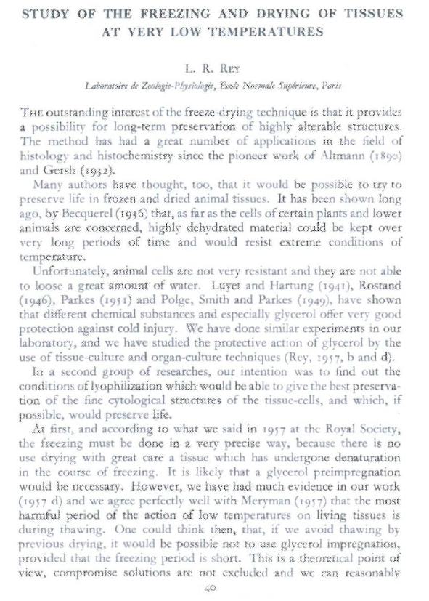
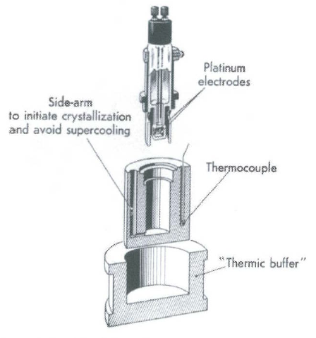
_{Louis Rey 1960s}
Rey (1960) Study of freezing and drying of tissues at very low temperatures. In Parkes and Audrey eds. Recent research in freezing and drying, Blackwell, Oxford.
Notes:
…….. And so how do we use impedance analysis in lyo cycle development?
One of the first applications was demonstrated by Louis Rey in the 1960s

Slide 8
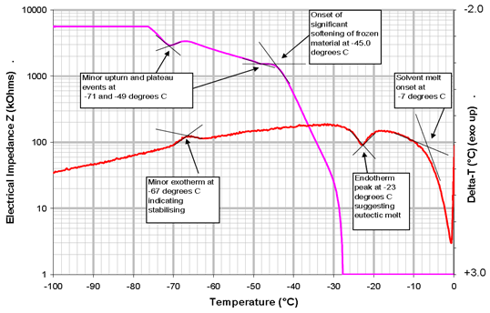
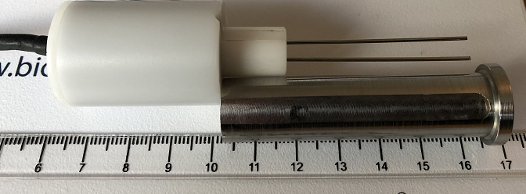

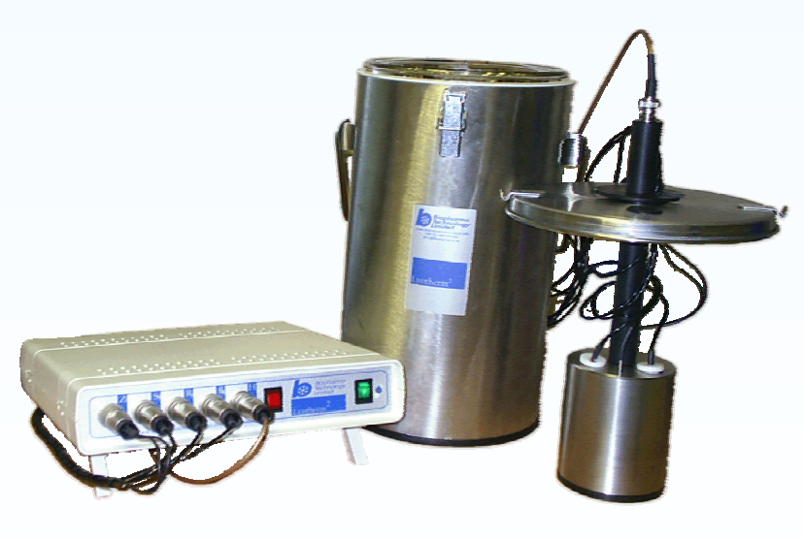

Lyotherm
Biopharma Process Systems
Designed to measure temperatures
relevant to freeze-dried formulations
glass transition (T_{G}’)
ice melting (T_{M}) and eutectic (T_{EU})
Impedance analysis (Zsinφ ) at a single frequency (1 kHz) with
differential thermal analysis (DTA)
Pin electrode (pair)
Integrated within cryostat
Ward & Matejtschuk , 2010 in Freeze Drying/ Lyophilization of Pharmaceutical & Biological Products 3rd ed. Rey,L & May JC eds, Informa Press, New York
Notes:
and is now embodied in the Lyotherm instrument from Biopharma
This system combines
an electrical impedance measurement at a single excitation frequency of 1 kHz
with a differential thermal analyser
(Click) It’s used for the determination of product specific temperatures,
including the glass transition, and melting points
associated with ice and any crystalline solutes such as mannitol

Slide 9
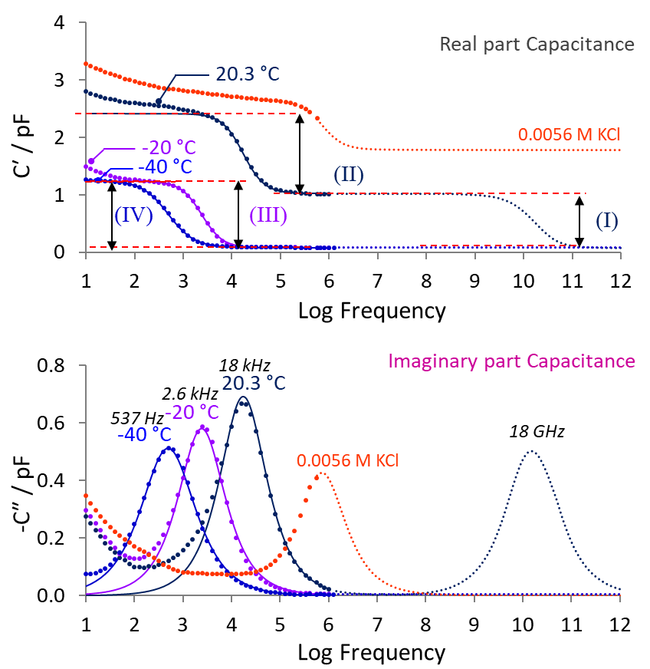
Dielectric loss or dielectric permittivity analysis?
Design space solutions ……
Electrical Impedance Spectroscopy Process Analytical Technology
Test object is measured at a range of discrete frequencies
Notes:
What I’d like to do next
is to profile some of the applications for eisPAT
in the development of the design space
With a spectroscopic method
the impedance of the test object is measured at a range of discrete frequencies
[click]
in order to build the spectral response
This differentiates our approach from a single frequency measurement used in Lyotherm and LyoRx

Slide 10
Dielectric loss or dielectric permittivity analysis?
Design space solutions ……
Electrical Impedance Spectroscopy Process Analytical Technology
Test object is measured at a range of discrete frequencies
  Novocontrol BDS
  Broad Band Dielectric Spectroscopy (sub Hertz to 10 MHz)
  Formulation development
Process development
  IDE
  Inter-digitated electrodes
  Micro-sample measurement
  TVIS
  Through-vial impedance spectroscopy for in vial measurement
Notes:
There are very good commercial systems on the market for such measurements,
for example the Novocontrol range of broadband dielectric spectrometers
And so firstly, I wanted to describe how these can be modified for either
(click) micro-sample analysis using commercially available interdigitated electrodes for formulation development
(click) or for in-vial determination of critical temperatures on more process representative samples volumes

Slide 11
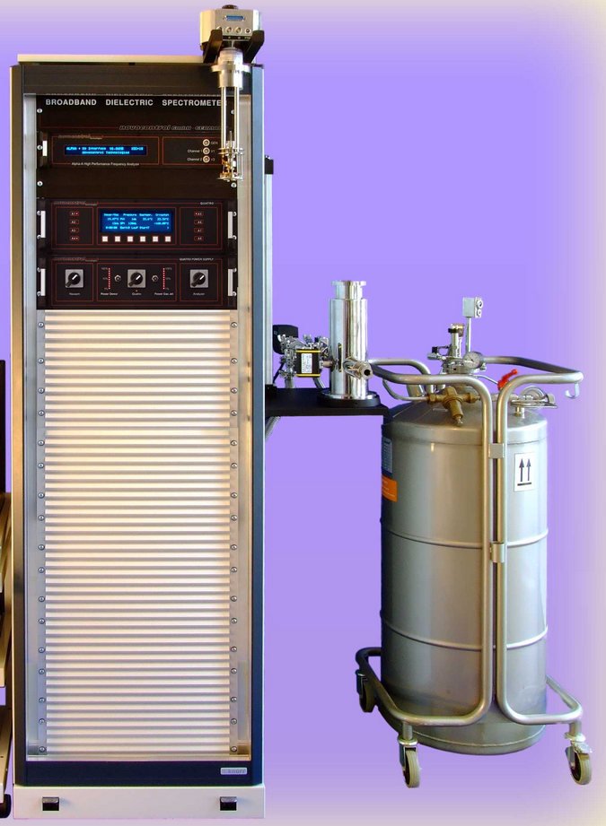
Spectroscopy Systems (sub Hz to 10 MHz)
Novocontrol
BDS system
Novocontrol
BDS system
Notes:
Here on the left is the Novocontrol BDS system with the sample holder and the active head of the spectrometer on suspended on a rack
…. (click)

Slide 12
Spectroscopy Systems (sub Hz to 10 MHz)
Novocontrol
BDS system
Notes:
To the right of the spectrometer is the cryostat (click)
with its liquid nitrogen Dewar

Slide 13
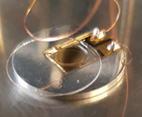
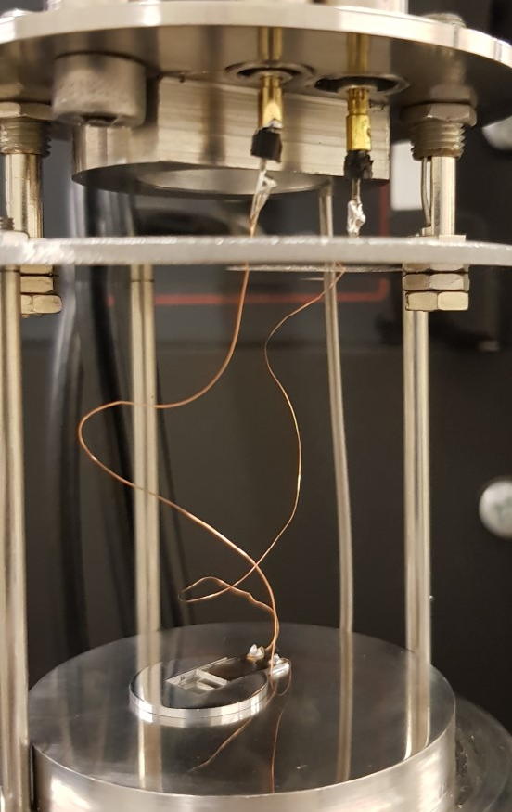
Spectroscopy Systems (sub Hz to 10 MHz)
OPTION 1 Inter-digitated microelectrode array
IDE: 2 μL volume
IDE
Adapter -spacer
Cover
slip
Placed on a cradle
Notes:
on the left you can see one of the IDEs (click)
These were sourced from a company called Micrux in Spain
In order to make the measurement we have designed
(click) an adapter to hold the IDE
Which also creates a sample space when the cover slip is placed on top
(click) because the adapter-spacer is approx 10 microns thicker than the IDE glass substrate
We then place that on a cradle (click) which is then lowered into the cryostat
(click)

Slide 14
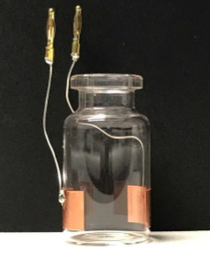
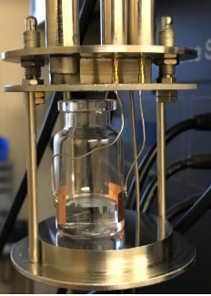
Spectroscopy Systems (sub Hz to 10 MHz)
OPTION 2 TVIS vial 2-3 ml volume
Copper
foil
electrodes
Placed on the cryostat “cradle”
Notes:
In the next system we have a standard vial with electrodes attached to the outside (click)
Which again is also placed on the cradle (click) and lowered into the cryostat (click)

Slide 15
The story so far ……..
Note that the technologies described so far are only capable of measurements during freeze-thawing cycles
A bit like a DSC style measurement
Notes:
Note that the technologies described so far
are only capable of measurements during freeze-thawing cycles
Which is a bit like one has in a DSC style measurement

Slide 16


Dielectric loss or dielectric permittivity analysis?
Design space solutions ……
Electrical Impedance Spectroscopy Process Analytical Technology
  Bespoke instrumentation
  Integrated within freeze-drying platforms
Process development
  Formulation development
  TVIS
  Through-vial impedance spectroscopy
  Z-FDM
  Impedance-enabled
  freeze-drying microscopy
Notes:
The freeze-drying applications we have studied so far
Required the development of bespoke instrumentation (click)
in order to be able to measure the sample during an actual lyophilisation cycle.
(click) Most of the work to date has concerned the TVIS technology that was developed via various Innovate UK project grants
(click) It is only recently, in the last two years, that we started to develop the Z-FDM technology with our partner Biopharma Process Systems

Slide 17
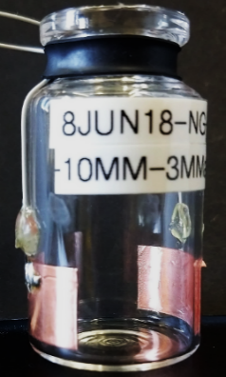
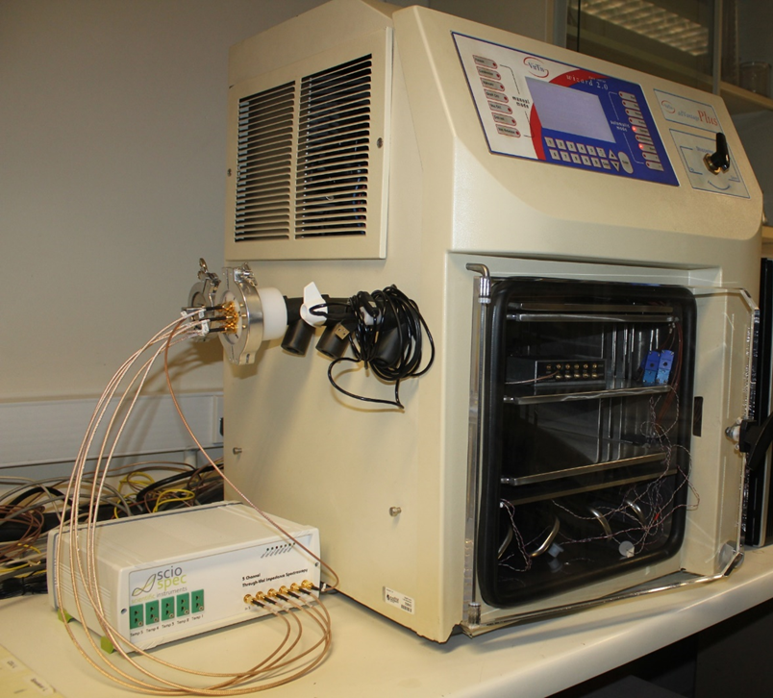
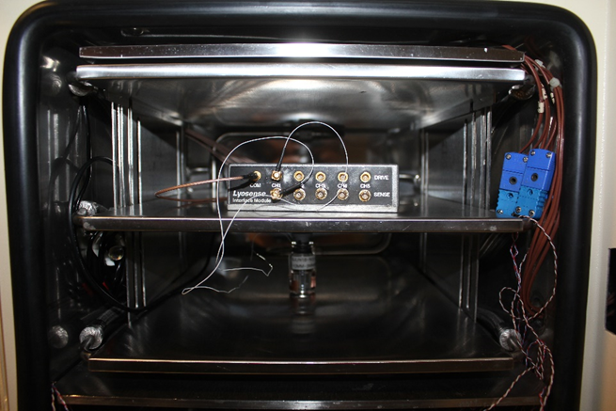
Spectroscopy Systems : TVIS
Modified glass vial
TVIS (Through-Vial Impedance Spectroscopy)
Pass through
Placed within the dryer
Junction box
vial
spectrometer
Notes:
So first up is the TVIS system
(click) with the modified glass vial carrying the measurement electrodes
(click) which is placed inside the dryer
(click) and then connected to the junction box
(click) which then connects to the spectrometer outside the dryer
(click) via a pass-through on one of the existing ports of the dryer

Slide 18
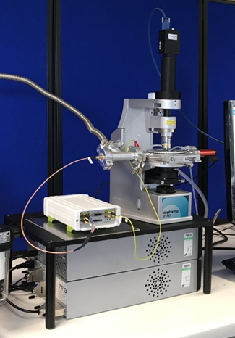
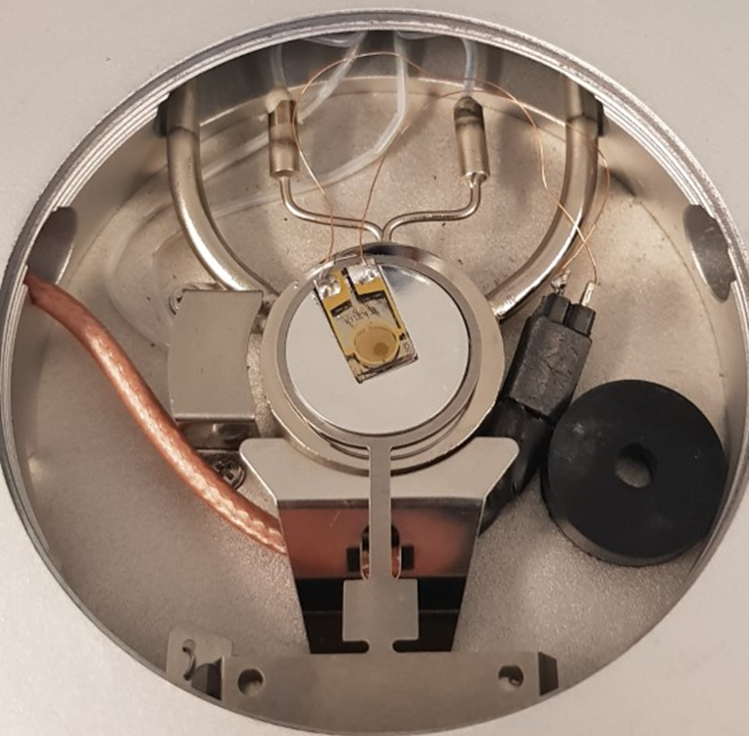
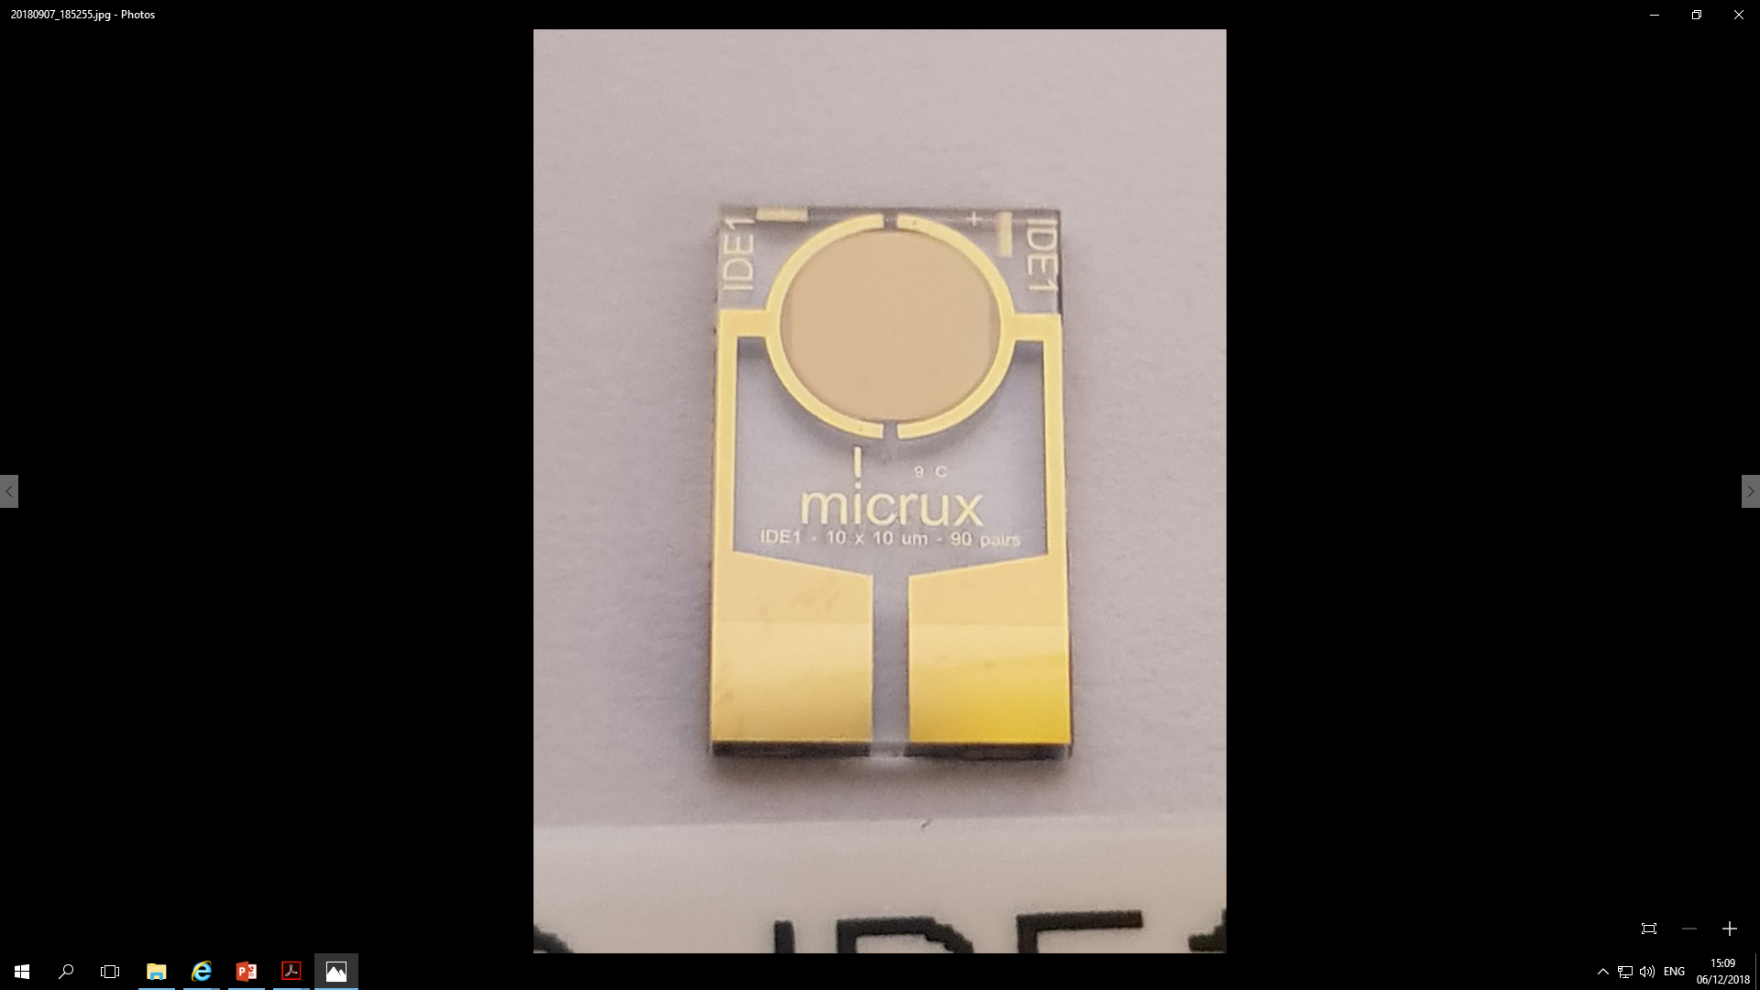
Spectroscopy Systems : Z-FDM
Integrated within the FDM stage
Developed in partnership with Biopharma Process Systems
on Innovate UK funded FAstLyo project ref. 133425 (2018-19)
Inter-digitated electrode
Notes:
Next is the freeze-drying microscope Z-FDM
(click) with an integrated IDE system,
(click) again based on the Micrux electrode arrays

Slide 19
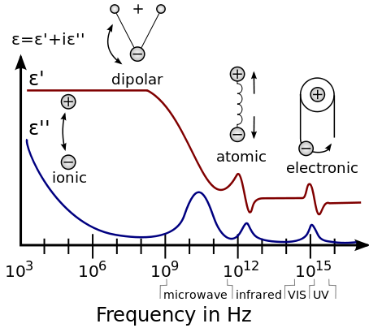


Dielectric Loss Mechanisms
The polarization of the water dipole in liquid water at 20 ˚C, with a dielectric loss peak frequency of ~ 18 GHz
Real part Capacitance
$ε_{s}$~ 80
$ε_{∞}$~ 3
(I)
TVIS range
Imaginary part Capacitance
18 GHz
https://en.wikipedia.org/wiki/Permittivity
Notes:
Having described the various hardware systems
Next I’d like to give an overview of the
wide range of processes that can be measured
The first process
which the dielectric relaxation of liquid water
can not be measured with the systems I have described
However, its worth mentioning
because there is a similar process for ice
that I will come onto later

Slide 20

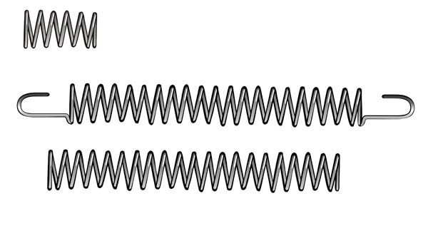



Dielectric Loss Mechanisms
Application: Determine cell constant and
convert measured capacitance C_{S}
to dielectric constant ε
Maxwell-Wagner (MW) polarization of the glass wall of the TVIS vial at +20 ˚C, with a dielectric loss peak frequency of 17.8 kHz
Real part Capacitance
20.3 °C
(II)
Measurement vial
$$C_{s}$$
$$C_{G}$$
(I)
$$R_{s}$$
+
+
+
+
+
+
+
+
+
+
-
-
-
-
-
-
-
-
-
-
+
+
+
+
+
+
+
+
+
+
-
-
-
-
-
-
-
-
-
-
18 kHz
Imaginary part Capacitance
Electronic polarization
Grotthus mechanism
Ionic diffusion
20.3 °C
H⁺
H⁺
HCO₃⁻
H⁺
OH⁻
18 GHz
$$E$$
o
+
H
H
o
o
H⁺
OH⁻
-
H⁺
H
H
H
Na⁺
H
Cl⁻
Atomic polarization
Dipolar polarization
δ⁻
δ⁻
δ⁻
δ⁺
o
δ⁺
o
δ⁺
o
+
δ⁺
δ⁺
δ⁺
-
H
H
H
H
H
H
$$\overline{P}$$
$$\overline{P}$$
$$\overline{P}$$
Glass wall
Water
Notes:
The next process is unique to the TVIS measurement
and is caused by the polarization of the glass wall
through the conductivity of water within the vial
Is known as a Maxwell-Wagner or Interfacial charging process
[click] We have used this process to calibrate the system
in order to determine the cell constant of the vial
Once you have the cell constant then you can
convert measured capacitances into dielectric constant

Slide 21
Dielectric Loss Mechanisms
Application: Determine leaching of ions
from the glass vial
Maxwell-Wagner (MW) polarization of the glass wall of the TVIS vial at +20 ˚C, with a dielectric loss peak frequency of 17.8 kHz
Real part Capacitance
20.3 °C
pure
water
(II)
0.0056 M KCl
Measurement vial
$$C_{s}$$
$$C_{G}$$
(I)
TVIS range
$$R_{s}$$
+
+
+
+
+
+
+
+
+
+
-
-
-
-
-
-
-
-
-
-
+
+
+
+
+
+
+
+
+
+
-
-
-
-
-
-
-
-
-
-
18 kHz
Imaginary part Capacitance
Electronic polarization
Grotthus mechanism
Ionic diffusion
20.3 °C
H⁺
Cl⁻
K⁺
H⁺
HCO₃⁻
H⁺
pure
water
o
18 GHz
$$E$$
H
H
o
0.0056 M KCl
+
o
H
H
H⁺
OH⁻
-
H⁺
H
H
Na⁺
Cl⁻
K⁺
Atomic polarization
Dipolar polarization
δ⁻
δ⁻
δ⁻
δ⁺
o
δ⁺
o
δ⁺
o
+
δ⁺
δ⁺
δ⁺
-
H
H
H
H
H
H
$$\overline{P}$$
$$\overline{P}$$
$$\overline{P}$$
Glass wall
Water
Notes:
As you can see here
from the addition of low levels of electrolyte (5.6 mM KCl)
That the characteristic frequency and the amplitude of the process are strongly dependent
on the conductivity of the liquid
One application might be to determine
the contamination of water from soluble components in the glass

Slide 22
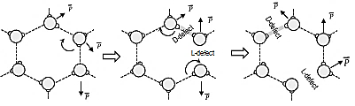

Dielectric Loss Mechanisms
Application: Ice mass
The dielectric polarization of ice at −20 ˚C, with a dielectric loss peak frequencies of 2.57 kHz
Real part Capacitance
20.3 °C
-20 °C
0.0056 M KCl
Measurement vial
(II)
$$C_{s}(∞)$$
(III)
$$C_{G}$$
(I)
Co
$$R_{s}$$
+
+
+
+
+
+
+
+
+
+
-
-
-
-
-
-
-
-
-
-
+
+
+
+
+
+
+
+
+
+
-
-
-
-
-
-
-
-
-
-
18 kHz
Imaginary part Capacitance
Electronic polarization
2.6 kHz
20.3 °C
L- and D- orientation defects
-20 °C
18 GHz
$$E$$
0.0056 M KCl
-
+
Atomic polarization
-
+
Glass wall
Ice
Notes:
The next one is particularly interesting because it relates to the formation and properties of the ice fraction
There are a number of applications for this process
The first is the determination of the amount of ice that forms

Slide 23
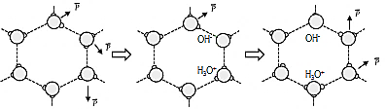
Dielectric Loss Mechanisms
Application: average ice temperature
The dielectric polarization of ice at −40 ˚C with a dielectric loss peak frequencies of 537 Hz.
Real part Capacitance
20.3 °C
-20 °C
0.0056 M KCl
-40 °C
(II)
Measurement vial
$$C_{s}(∞)$$
(IV)
(III)
(I)
$$C_{G}$$
Co
$$R_{s}$$
+
+
+
+
+
+
+
+
+
+
-
-
-
-
-
-
-
-
-
-
+
+
+
+
+
+
+
+
+
+
-
-
-
-
-
-
-
-
-
-
18 kHz
Imaginary part Capacitance
Electronic polarization
2.6 kHz
20.3 °C
Ionic defects
(similar to Grotthus mechanism)
537 Hz
-20 °C
-40 °C
18 GHz
$$E$$
0.0056 M KCl
-
+
Atomic polarization
-
+
Glass wall
Ice
Notes:
You can see from this temperature change from -20 degC to to -40 degC
That the relaxation frequency of the dielectric loss peak [click]
Has a strong temperature dependence [click]
With a shift of one order of magnitude with a 20 deg C change in ice temperature [click]
Which can be exploited as a method for the non-invasive determination of the average ice temperature [click]

Slide 24
Dielectric Loss Mechanisms
Application: high frequency real part
Capacitance for ice growth end point
10 Hz
temperature
dependent
100 kHz
temperature
independent
Notes:
Now if we focus on the real part capacitance and review the changes
as we transition [click] from liquid state at +20 C to the frozen state at -20 and – 40 degrees C
You can see that the capacitance of the ice changes with temperature at low frequency [click]
But is largely independent of temperature at high frequency [click]
Which can be exploited as a method for [click]
the determination of the ice growth end point

Slide 25
TVIS publications suggestive of Z-FDM applications
Smith, G. & Jeeraruangrattana, Y. 2019, "Chapter 5 Through-Vial Impedance Spectroscopy (TVIS): A New Method for Determining the Ice Nucleation Temperature and the Solidification End Point " in Freeze Drying of Pharmaceutical Products, eds. D. Fissore, R. Pisano & A. Barresi, 1st edn, CRC Press, Florida, United States
Jeeraruangrattana, Y., Smith, G., Polygalov, E. and Ermolina, I. (2020) Determination of ice interface temperature, sublimation rate and the dried product resistance, and its application in the assessment of microcollapse using through-vial impedance spectroscopy. European Journal of Pharmaceutics and Biopharmaceutics, 152, pp. 144-163
Smith, G., Jeeraruangrattana, Y., Ermolina, I. (2018). The application of dual-electrode through vial impedance spectroscopy for the determination of ice interface temperatures, primary drying rate and vial heat transfer coefficient in lyophilization process development. European Journal of Pharmaceutics and Biopharmaceutics
Smith, G., Arshad, M.S., Polygalov, E., Ermolina, I., McCoy, T.R., Matejtschuk, P. (2017). Process Understanding in Freeze-Drying Cycle Development: Applications for Through-Vial Impedance Spectroscopy (TVIS) in Mini-pilot Studies. Journal of Pharmaceutical Innovation, 12 (1), pp. 26-40 Key observation was the potential to measure temperature non-invasively
Arshad, M.S., Smith, G., Polygalov, E., Ermolina, I. (2014). Through-vial impedance spectroscopy of critical events during the freezing stage of the lyophilization cycle: The example of the impact of sucrose on the crystallization of mannitol. European Journal of Pharmaceutics and Biopharmaceutics, 87 (3), pp. 598-605
Smith, G., Arshad, M.S., Polygalov, E., Ermolina, I. (2014). Through-Vial Impedance Spectroscopy of the Mechanisms of Annealing in the Freeze-Drying of Maltodextrin: The Impact of Annealing Hold Time and Temperature on the Primary Drying Rate. Journal of Pharmaceutical Sciences, 103 (6), pp. 1799-1810
Smith, G., Arshad, M.S., Polygalov, E. and Ermolina, I. (2013) An application for impedance spectroscopy in the characterisation of the glass transition during the lyophilization cycle: The example of a 10% w/v maltodextrin solution. European Journal of Pharmaceutics and Biopharmaceutics, 86 (3 Part B), pp. 1130-1140.
Nucleation Temperature and the Solidification End Point
Notes:
I said that most of the work we have done to date
relates to the use of TVIS in the determination of various process parameters
(click) One of our most recent profiles the application I just mentioned
i.e. the use of TVIS in the non-invasive determination of nucleation temperature and solidification end point

Slide 26
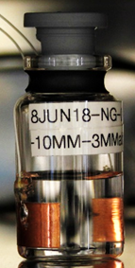
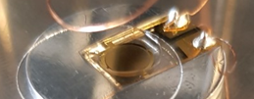
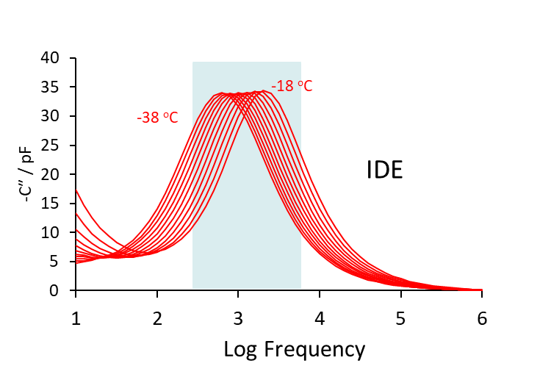
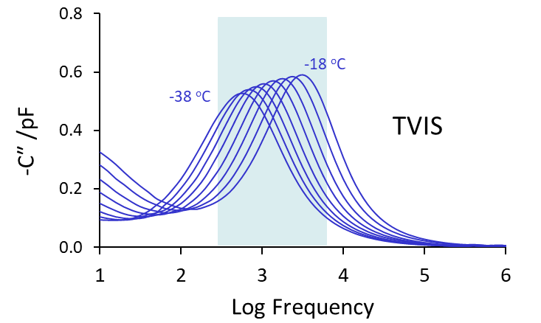
Dielectric relaxation of ice
5 mL water in
10 mL glass TVIS vial
(1 pair of 10/19 mm height/width electrodes)
10/10 μm electrode width/spacing
2 µL water over IDE
(90 pairs of gold interdigitated electrodes)
1.6 kHz temperature sensitive
Notes:
So it was based on these TVIS applications
that we started to look at applications for inter-digitated electrodes inside a freeze-drying microscope
You can see from the dielectric loss peak for ice that both systems display similar
but not exactly the same characteristics [CLICK]
And we can put this down to the influence of the glass wall on the TVIS measurement
[click] I have highlighted here the frequency of 1.6 kHz
Because that is the frequency I am going to focus on
In my studies freeze-drying microscope

Slide 27
Applications in freezing (nucleation temperature, ice growth rates, solidification end point)
Observations on Sample Size
Case study of 5% w/v Sucrose Solution
Notes:
The first relates to ice nucleation, growth and end point

Slide 28
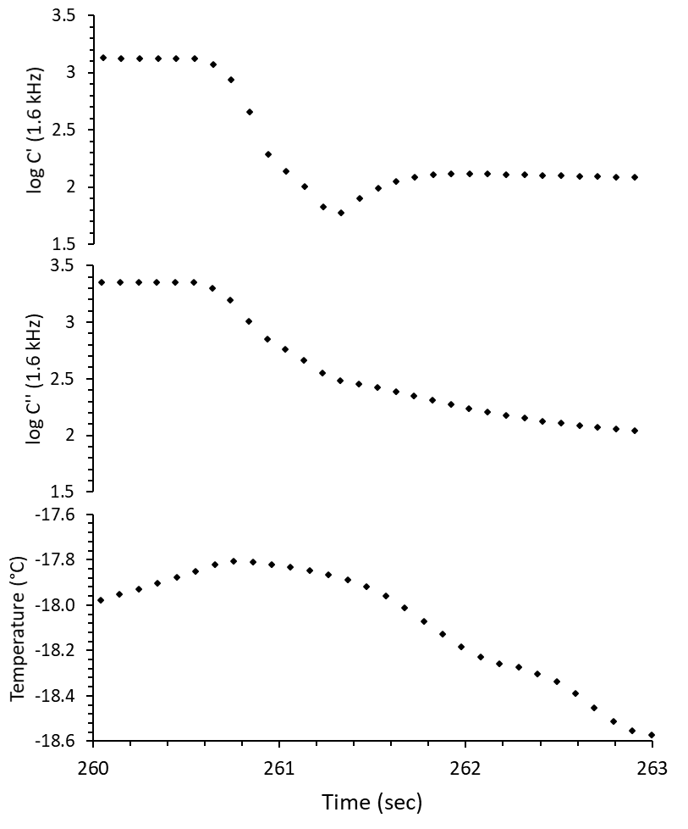
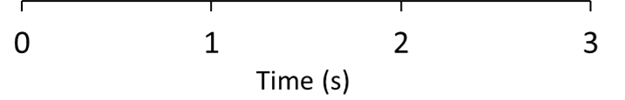
Nucleation of 0.5µL of 5% Sucrose
Notes:
The top two graphs show the real and imaginary capacitance at the measurement frequency of 1.6 kHz
Whereas the bottom graph shows the temperature of the FDM stage
The temperature profile of the stage looks a bit odd
– at first appearing to increase [click] before then decreasing [click]
but this is typical of the temperature control of the stage
which undulates to some degree as the temperature is ramped.

Slide 29
Nucleation of 0.5µL of 5% Sucrose
B. Ice solidification
end point time/temp
A. Nucleation
Temperature/time
Notes:
The first point of interest is ice nucleation
[click] at time-line A
This point is shown by
[click] an inflection in the real part capacitance
[click] and an inflection in the imaginary capacitance [click]
The second point of interest is the ice solidification end point
[click] at time-line B
However, this only shown by
[click] an inflection in the real part capacitance.
[click] The imaginary capacitance continues to change through this point
because it is much more sensitive to the change in the temperature of the sample [click]

Slide 30
Nucleation of 0.5µL of 5% Sucrose
B. Ice solidification
end point time/temp
A. Nucleation
Temperature/time
C. Mean ice growth
Temperature – 17.9
Time difference between time points A and B is the ice solidification time and hence provides an opportunity to measure ice growth rates at the mean ice growth temperature (C)
Ice solidification
time = 1.2 s
Notes:
and so if we know the start of ice formation [click]
and end of ice formation [click]
we can work out the ice growth rates [click]

Slide 31
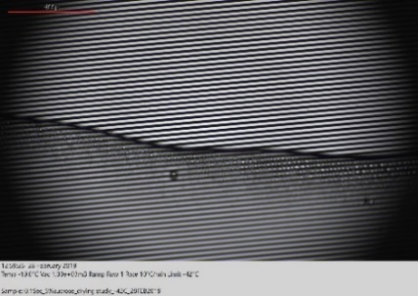
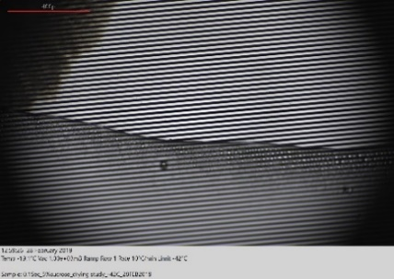
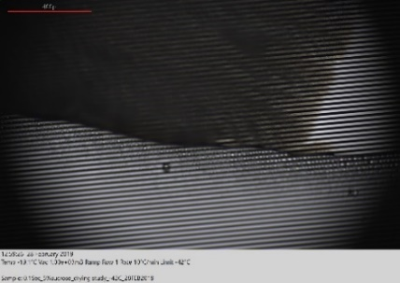
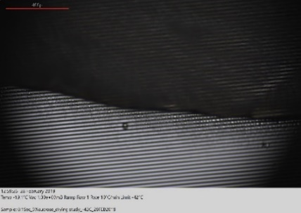
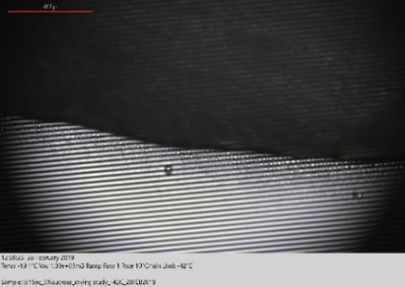
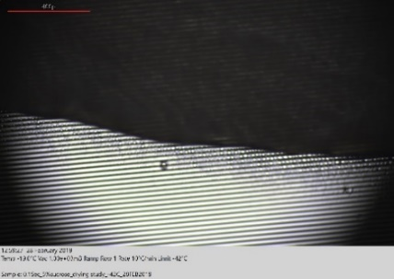
Nucleation of 0.5µL of 5% Sucrose
1
3
5
1
2
2
6
4
B. Ice solidification
end point time/temp
3
4
A. Nucleation
Temperature/time
5
6
Notes:
In contrast we don’t always see the same transitions in the images of the FDM microscope
Because they happen off screen so to speak
[click] This first image was acquired after the nucleation point A but doesn’t show any evidence of ice formation
[click] Its only when we record the next image that we see evidence of ice formation
[click] And in the third image shows the ice moving across the screen
[click] then by the time the 4th image is recorded the ice front has moved out of view
But the impedance data for image 5 shows that the process has not yet completed until image 6 is aquired

Slide 32
Ice growth rates
Assumption: unfrozen fraction comprises 80:20 ratio of sucrose to water
1 mL of 5% w/w sucrose has 0.95 g water
It follows that 0.0125 g (0.05 x 20/80) is bound and produces 0.9375 g ice
Estimated from:
0.5 µL of 5% sucrose (produces 4.688E-04 g ice)
Ice formation time = 1.2 s (12 data points)
Ice growth rate: 4.688E-04 / 1.2 = 0.39 mg/s
Relevance in formation design :
ice crystal size? Dry layer resistance Rp and drying rates
Notes:
With some simple calculations
based on assumptions concerning how much ice would form from the solution
(and the ice formation time from Z-FDM)
(click) We can calculate average growth rates
Here an average growth rate of 0.39 mg/s is recorded
[click] If we accept relative measurements of growth rates as a function of product formulation
Then it might give some indication of relative differences in ice crystal sizes,
and hence dry layer resistances and associated drying rates of different formulations

Slide 33
Dielectric loss or dielectric permittivity analysis?
Applications in primary drying (drying rate, product collapse)
Freeze drying of 5% sucrose (0.05μL)
Studied by Image analysis
Notes:
The next slides explore the application of Z-FDM in primary drying
But first we need to start with some work with did with image analysis

Slide 34
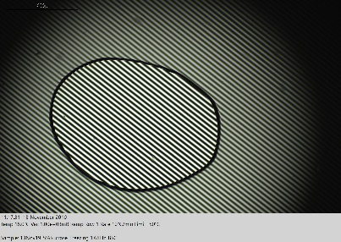
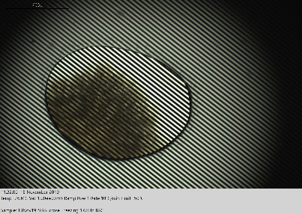
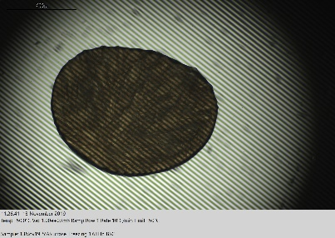
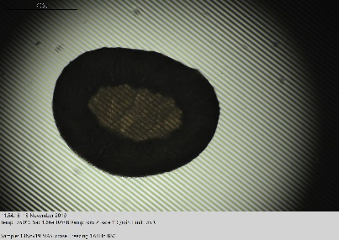
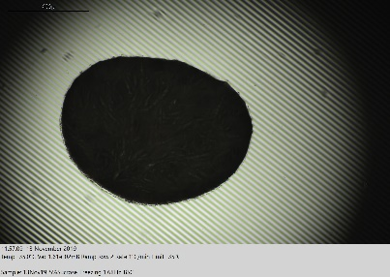

FDM protocol
Liquid state
ice growth
A
ice solidification
sublimation
end of primary drying
B
C
D
E
Time period for image analysis by Matlab
set temperature for the FDM stage
FDM freeze-drying of 5% sucrose solution (0.05 μL)
NB: Temperature and pressure measured on FDM every 100 ms
Notes:
The profile shown here is the set temperature for the FDM stage.
[click] Initially (at point A) the sample is in the liquid state
[click] as the temperature of the sample is reduced then we reach point B when ice appears in the image
[click] and almost immediately afterwards you reach the solidification end point (point C)
[click] after the vacuum is applied there is a loss of ice (as shown by a darkening around the perimeter of the image) – point D
[click] before reaching the end point E when all the ice has been removed.

Slide 35




MATLAB® Image analysis (pixel counting)
FDM primary-drying of 5% sucrose soln (0.05 μL) at -35˚C
Global templet generation – dried product image
Threshold test image – frozen image or drying stage image
MATLAB®
Global pixel : 527515
Dried product image
MATLAB®
Pixel for central area: 86317
Product during drying
Notes:
The next stage was to apply image analysis using a code written in MatLab
In the first step, we counted the dark pixels associated with the dried solution
And then we counted backwards to determine the ice layer from the white pixel count

Slide 36



Pixel analysis
vacuum stabilises
vacuum applied
A: Application of vacuum
NB: Temperature and pressure measured every 100 ms
Notes:
On the left scale you have the pixel count and the corresponding data (coloured in red, then yellow, then blue and finally green)
The red data shows the constant pixel count owing to the fact that drying hasn’t started
(click) Then immediately after the vacuum is applied there is an initial fast rate of drying (shown by the yellow line)
[click] which then slows down as the vacuum bottoms out to its set value
At that point and thereafter there is an almost linear decrease in ice mass
(which can be modelled satisfactorily by a second order polynomial)

Slide 37


Drying rate determination
0.8 mm
76µm
Weight fraction of sucrose | 0.05 | (5% Sucrose)
Weight fraction of water | 0.95 | i.e. 95 % water
Weight fraction of bound water (1) | 0.0125
Weight fraction of freezable water | 0.9375
Sample volume | 0.05 | µL
Freezable water | 0.0469 | µL
Freezable water in mg | 0.0469 | mg of ice
Total pix before drying starts | 466873
1 pixel (a) | 1.004E-07 | mg of ice
Gradient of linear part (b) | 132110 | pixel per min (yellow line)
Drying rate (a x b) | 0.0133 | mg min⁻¹
Drying rate (B) | 0.00080 | g h⁻¹
Area of perimeter of sample (A) | 0.00342 | cm²
Specific drying rate (B/A) | 0.233 | g h⁻¹ cm⁻²
Area of perimeter
0.00342 cm²
0.62 mm
(1) based on 80:20 ratio of sugar to water in freeze-concentrated solution
NB: Sample thickness assumed from the Lactose sample analysed in the same setup.
Example drying rate from a 10 mL glass tubing vial is 0.25 g h⁻¹
Vial diameter : 22 mm Internal area : 3.8 cm⁻¹
Specific drying rate : 0.065 g h⁻¹ cm⁻²
Difference due to differences in heat transfer etc.
Notes:
With a few more calculations (again with some assumptions) we can arrive at an estimate for the specific drying rate.
Which in this case turns out to be 0.233 g per hour per cm2
This drying rate is must faster than the specific drying rate of 0.065 g per hour per cm2
that is observed in a glass vial
These differences are a consequence of differences in heat transfer etc.

Slide 38



Drying rate at different gradient
Application of vacuum
A
B
B
B
C
C
B
Drying Rates
At A Initial – 0.00080g h⁻¹
At B: Middle – 0.00050 g h⁻¹
At C: Middle – 0.00041 g h⁻¹
NB: Temperature and pressure measured every 100 ms
Notes:
From the polynomial fit we can then estimate how the drying rate changes over the quasi-linear period from an initial rate of 0.0005 g h-1 to 0.0004 g h-1 – a 20% decrease in drying rate

Slide 39
Dielectric loss or dielectric permittivity analysis?
Freeze drying of 5% sucrose (0.05μL)
Studied by Z-FDM
Notes:
Now turning our attention to the impedance aspects of the Z–FDM measurement

Slide 40






Drying: Image analysis vs Capacitance during drying of 0.05 µL 5%sucrose
I
II
III
IV
A
B
Linear relationship between real part capacitance C’ and pixel count (ice content) confirms the opportunity to use Z-FDM for drying rate estimation
A
I: Application of vacuum. Primary drying starts
II: Both gradients of imaginary and real part capacitance change towards the end of drying
II : end of primary drying
IV: Ramped to RT and capacitance remains unchanged with temperature
B
Notes:
Again , we can look at the real and imaginary capacitances as measured at 1 point 6 kHz
To find that its the real part that gives a more reliable profile (click)
And so if we plot the real part against the pixel count
[click] we can see that there is good linear relationship
We might therefore conclude that Z-FDM could be used for a drying rate estimation

Slide 41
Dielectric loss or dielectric permittivity analysis?
Annealing of 5% sucrose (0.05μL)
Studied by Z-FDM
Notes:
Next we will take a look at how Z-FDM can be used to characterise the annealing stage

Slide 42






Full process
0.05 µL 5%sucrose
A
Annealing stages
B
C
D
E
Capacitance data measured at 1.6KHz
Notes:
Again we display the real and imaginary capacitances at 1 point 6 kHz above the temperature for the FDM stage
After the initial freezing stage
[click] there are three annealing cycles
[click] which bring the temperature up to – 25 deg C
which is above the glass transition of the sucrose solutions [click]

Slide 43

Annealing (1.6KHz)
0.05 µL 5%sucrose
Structural changes on re-heating
decrease with each annealing
Excursions in temperature just above the glass transition
Sucrose Tg’
Notes:
This slide provides a closer look at the impact of temperature-cycling on the Z-FDM response
But here, it is the imaginary capacitance that provides the most interest
[click]
you can see that excursions above the glass transition temperature result in inflections in the imaginary capacitance
[click]
However, what is more interesting is the change in the imaginary capacitance,
each time the temperature is increased through the glass transition
[click]
On first pass, the changes are so much larger, than subsequent annealing
Which suggest that the ice crystal structure is becoming more stable with each annealing

Slide 44
Applications in primary drying : product collapse
Collapse of 5% sucrose (0.5 µL)
Studied by Z-FDM
Notes:
In the last part we will take a look at how Z-FDM can be used for a more traditional application for freeze-drying microscopy, namely the study of the collapse temperature

Slide 45


TASC – image analysis of sucrose solution
Reduces operator error in the analysis of the collapse temperature and can use for drying rate.
A
B
A
B
Collapsed layer
T_{c} −32.1°C
T_{c}(onset) −33.3˚C
Adapted from: Ward, K. and Matejtschuk, P., 2019. Chapter 1 Characterization of Formulations for Freeze-Drying In: K. R. WARD and P. MATEJTSCHUK, eds, Lyophilization of Pharmaceuticals and Biologicals: New Technologies and Approaches. 1 edn. New York: Humana Press, pp. 1-33.
Images coinciding with TASC features
onset of collapse at −33.3°C, and
full collapse occurring at −32.1°C
Notes:
The first step was to use Biopharma’s TASC software for image analysis
Given that is less subjective than visual observations made by the operator
This allowed us to determine the onset of collapse at – 33.3 degrees C

Slide 46



Collapse Observation at 1 kHz
Vacuum applied
II
I
I
III
II
Collapse temperature
determined at −34.5 °C
III
NB: 0.5 μl of 5% Sucrose soluiton

Slide 47
Take home messages (from measurements at 1.6 KHz)
Real and imaginary part capacitances can be used for the determination of ice nucleation and ice growth rates
Pixel analysis works for drying rate determination
Real capacitance has a linear relationship with pixel count, and hence ice mass, so can be used for drying rate determination
Imaginary part capacitance can be used to study the annealing process but requires further work in order to be able to determine the glass transition temperature.
  Selection of a higher measurement frequency is likely to provide the answer to the glass transition temperature assessment
Step changes in drying rate (observed from real part capacitance) can be used to determine the collapse temperature

Slide 48









Acknowledgements
Evgeny Polygalov
TVIS technology development
Dr Yowwares Jeeraruangrattana
Thai Government Pharmaceutical Organization
for funding for Z-FDM development (FastLyo Project 133425)
In collaboration with ….
Anand Vadesa (PhD 2018-) Funded by UKRI – EPSRC
Prof. Paul Dalby
Notes:
In closing I’d like to thanks those made this work possible
[click] To Evgeny Polygalov, who designed and developed the original TVIS instrument
[click] To Dr Yowarres Jeeraruangrattana from the Thai Government Pharmaceutical Organization who’s PhD focussed on the development of applications for TVIS
[click] To Biopharma Process Systems (BPS) and Innovate UK for funding the Z-FDM development
[click] And to Anand Vadesa who is currently working on developing the Z-FDM applications on a PhD project
[click] funded by the EPSRC and co-supervised by Prof. Paul Dalby from UCL’s doctoral training college

Slide 49
Thank you for listening

Slide 50
Through Vial Impedance Spectroscopy (TVIS)
TVIS measurement relate to both the electrical resistance and electrical capacitance of the vial contents.
Monitoring Phase Behaviour (ice nucleation temperature and solidification end points
FPEAK temperature calibration for predicting temperature of the product in primary drying
Drying rate surrogate (from dC″_{PEAK} /dt )
Liquid State
Solid State
Drying time
-18 ºC
increase
-38 ºC
F_{PEAK}
F_{PEAK}
  C′ (real part of the complex capacitance) is highly sensitive to low ice volumes; therefore it could be used for determination end point of primary drying
Notes:
Eg temperature cycling below to calibrate Fpeak for temperature (in order to predict product temperatures in primary drying) and the compensate cpeak for temperature so that it can used to monitor ice content and hence drying rate
Eg 2 left graph: monitoring phase behaviour (ice nucleation temperatures and solidufication end points)

Slide 51

Temperature Calibration
Shelf Temp.
Product Temp.
TVIS
F_{PEAK} profile during annealing has ‘similar’ profile with product temperature.
Assuming thermal equivalence between the thermocouple (TC) vial and TVIS vial, then the temperature calibration from annealing might be employed for the prediction of temperature during primary drying
-40 ºC
-20 ºC
F_{PEAK}
Temperature
Notes:
Full Shelf Water Study_180817_Ch1 (Fill factor 0.7) 3mm gap –Dual electrode
Re-heat
Time/hr. TC1
6.5 -39.9
6.6 -37.2
6.7 -34.4
6.8 -31.6
6.9 -28.3
7.0 -25.4
7.1 -22.2
7.2 -19.4

Slide 52







Temperature Prediction in Primary Drying
Temperature calibration curve selected for temperature prediction in primary drying : T(F_{PEAK})
Good agreement between product temperature (by TC) and T(F_{PEAK})
Shelf Temperature ($T_{S})$
Before drying
during drying
Before
drying
during drying
$${T(F}_{PEAK})> T_{p}$$
$${T(F}_{PEAK})< T_{p}$$
$T_{p}$> ${T(F}_{PEAK})$
$$\frac{dQ}{dt}=L∙\frac{dm}{dt}$$
T(F_{PEAK})
TC
T(F_{PEAK})
TC
$$\frac{dQ}{dt}$$
$$\frac{dQ}{dt}$$
Notes:
Full Shelf Water Study_281016_Ch1 (Fill factor 0.9) 3mm gap

Slide 53

Compensation of C″PEAK by T(F_{PEAK})
13.67 h
T(F_{PEAK}) during primary drying is used for compensation
C″_{PEAK}
13.67 h drying
starts
Ĉ″_{PEAK}
Thermocouple
195 µbar
195 µbar
T(F_{PEAK})
−36 ºC

Slide 54

Drying rate calculation
(0.83 pF, 14.3 h)
(0.47 pF, 17.4 h)
Drying rate (g/h) for Ĉ″_{PEAK}

Slide 55


Summary
Temperature calibration of the TVIS parameter ($F_{PEAK}$) for ice during an additional temperature cycling stage applied to a prediction of ice temperatures during the initial (few hours) of primary drying
Temperature compensation of TVIS parameter ($C_{PEAK}^{″}$) allows for an accurate estimation of ice mass during primary drying as evidenced by comparable results of drying rate between the determined by TVIS and that determined (gravimetrically) by loss weight
Non-invasive real time information for characterising the freeze drying process

Slide 56



Future Work
Development mapping a drying characteristics from lab scale to production
  Determination of heat transfer coefficients ($K_{V}$)
  Determination of dry layer resistance ($R_{P}$) to predict drying efficiency
Investigation the molecular dynamic of the unfrozen fraction
  Monitoring product stability
  Examine the mechanical strength of the freeze dried product (i.e. collapse behaviour)
Develop (new) continuous drying technologies

Slide 57

Further Reading
Introduction to TVIS theory
Description of the measurement principles
Dielectric loss and relaxations mechanisms (liquid and frozen states)

Slide 58


Further Reading
Chapter 5 Through Vial Impedance Spectroscopy (TVIS) A New Method for Determining the Ice Nucleation Temperature and the Solidification End point
Notes:
Baook cover

Slide 60







Glass Transition (T_{g}ʹ) Determination
5% w/v Lactose solution
Log scale
Initial (5.33 h)
Linear scale
C_{1B}
C_{1A}
C₂
5.83 h
R_{1B}
R_{1A}
-9.99 -16.74 -23.15 -29.25 -35.05 -40.59 -45.88 -50.93 ºC
6.33 h
Below T_{g}ʹ the changes in product resistance follows Arrhenius
Above T_{g}ʹ VTF function models the resistance profile.
Notes:
Full shelf 5%w/v Lactose in ultrapure water 25Nov16_CH4

Slide 61





Lactose Dried Product Resistance (R_{P})
9.1 mm
3 mm
$$\hat{R}p=\left(\frac{PICE −P\text{CHAMBER}}{{dm}/{dt}}\right)∙AP$$
$$\ln{(P ICE)}=\left(\frac{−6144.96}{Tp or TC}\right)+24.02$$
$$PICE −P\text{CHAMBER}$$
$${dm}/{dt}$$
1.75cm²·Torr·h·g⁻¹
Notes:
Version 14
If we are now calculating Rp then we only need to show the product temperature (Tfpeak) and the condenser temperature
Then below that the values for partial pressure – to replace the log Fpeak plot
Then the drying rate (ice vs time) and not c”peak vs time on the bottom left
Replace the top right with my new Rp values
Full shelf 5%w/v Lactose in ultrapure water 23Jan17-CH3 (Fill factor 0.7 = 3.04 g)-3mm above base electrode
From the literature (Pikal (1985) PDA Journal of Pharmaceutical Science and Technology, 39(3), pp.115-139.): Rs ~0.33 Torr·h·g-1.
The temperatures we are using (calculated from log Fpeak) have not been smoothed and the values for C"peak (although taken from the moving average) both have scatter to them - hence why the plot of Rp vs dry layer is quite noisy
Rp starts at 2 (which I presume is the stopper resistance) then it increases as the dry layer develops in thickness up to 3 mm - which is the point at which micro-collapse has happened. At that point, the overall resistance decreases which means that microcollapse has also occurred in the layer above the ice - which already has no ice. If there was no microcollapse in that layer then Rp would stay constant after 3 mm of the dry layer develops. Instead, Rp drops to a new value at ~ 4mm dry layer (when microcollapse occurs) and doesn't change after that. I presume that is because a more dramatic microcollapse occurs in the layers that develop below 4 mm - which are seen on our SEM as large pores and so the layers below the top 3 mm do not have a measureable dry layer resistance.
Milton et al. study product resistance by comparing the direct vial method and MTM (data shown in literature are from direct vial technique according to Pikal's method). They concluded that the product resistance value from MTM agree with direct vial technique and has the same pattern. For lactose, they reported that product resistance increases continuously with thickness up to the onset of collapse (below about -30 Celcius).

Slide 62




Lactose Dried Product Resistance (R_{P})
500X
Top layer
Fine pores
$$\hat{R}p=\left(\frac{PICE −P\text{CHAMBER}}{{dm}/{dt}}\right)∙AP$$
500X
3 mm
Middle layer
Micro-collapse
500X
3 mm
Bottom layer
Full collapse
Notes:
Full shelf 5%w/v Lactose in ultrapure water 23Jan17-CH3 (Fill factor 0.7 = 3.04 g)-3mm above base electrode
Img: 5%lactose_16Nov16-Ng03-10a

Slide 63










Examples of Biopharmaceuticals Therapy
Growth hormone
Endocrine system
Cardiovascular system
Integumentary system
Factor VIII helps blood to clot
Nivolumab
Treatment hemophilia
Treatment Melanoma

Slide 64

Monoclonal antibodies (mAb)
mAbs used for treatment cancer
Notes:
Glassman PM, Balthasar JP. Mechanistic considerations for the use of monoclonal antibodies for cancer therapy. Cancer Biology & Medicine. 2014;11(1):20-33. doi:10.7497/j.issn.2095-3941.2014.01.002.

Slide 65


Interdigitated electrodes
Interdigitated electrodes have been used in past for the prediction of lyophile collapse temperature
A
B
A: Showing individual components of a single surface, co-planer, interdigitated-comb sensor and B: the complete sensor
Mackenzie, A. P., Evans, S. A. and Morris,. Prediction of Lyophile Collapse Temperature by Dielectric Analysis Prediction of Lyophile Collapse Temperature by Dielectric Analysis, PDA J Pharm Sci and Tech 1994, 48 318-329.
Notes:
MORRIS, K.R. et al. Prediction of Lyophile Collapse Temperature by Dielectric Analysis Prediction of Lyophile Collapse Temperature by Dielectric Analysis, PDA J Pharm Sci and Tech 1994, 48 318-329.
Evans, S.A. et al. Dielectric Characterization of Thermodynamic First Order Events in Model Frozen Systems Intended for Lyophilization Dielectric Characterization of Thermodynamic First Order Events in Mode ! Frozen Systems Intended for Lyophiiization, PDA J Pharm Sci and Tech 1995, 49 2-8

Slide 66




Example interdigitated electrode (gold on glass)
Width of the electrode 3.5 mm Ø
Light aperture 1.3mm diameter
10 μm
10 μm
Electrode gap
Electrode width
Commercial IDE – MicruxTM
Notes:
http://www.linkam.co.uk/fdcs196-specifications
https://static1.squarespace.com/static/556d800ae4b0e8f91507450c/t/56cf3686f8baf3fe56cc48e2/1456420522066/FDCS196_T95_manual.pdf

Slide 67
Design of IDE holder
Top view
Theoretical sample height
6 mm
16mm
6 mm
10mm
10 mm
*
0.85 mm*
*IDE height 0.75 mm
* different height of IDE adaptors used for initial assessment:
0.85 mm
0.90 mm
0.95 mm
1.00 mm
IDE is lower than the adapter and sample height derived between difference between then IDE adaptor size
IDE dimensions:
10 x 6 x 0.75 mm
Notes:
https://static1.squarespace.com/static/556d800ae4b0e8f91507450c/t/56cf3686f8baf3fe56cc48e2/1456420522066/FDCS196_T95_manual.pdf

