Slide 1
Preliminary analysis of City Climate Plans: Case studies of UK cities and next steps
Subhes Bhattacharyya and Leticia Ozawa-Meida
Institute of Energy and Sustainable Development
De Montfort University, UK
6th September 2019

Slide 2
Aim and objectives
Conduct a preliminary analysis of the integration of the SDGs in the climate action plans of urban areas in the UK
To identify whether city-level climate actions consider sustainable development of cities
To explore the alignment of UK cities’ climate actions and plans with SDGs

Slide 3
UK Local Authority background
Education
United Kingdom
- 353 in England
- 22 in Wales
- 32 in Scotland
- 11 in Northern Ireland
URBAN
- 125 single-tier authorities
- 16% geographical area
- 53% population
56 Unitary Councils
36 Metropolitan Borough Councils
RURAL
- 228 two-tier authorities
- 84% geographical area
- 47% population
Country (principal authorities)
England (urban and rural authorities)
Local level
27 County Councils
33 London Borough Councils
201 District Councils
Local taxation
Highways
Transport planning
Passenger transport
Libraries
Social care
Housing
Leisure and recreation
Environmental health
Waste collection
Waste disposal
Planning application
Strategic planning

Slide 4
Legal and Policy Context
2008 Climate Change Act
80% emissions reductions by 2050 (1990 levels)
Section 62: Reporting requirements for LAs
Section 13: Consider SD in policies and proposals
Section 58: Adaptation to climate change
Schedule 7: Renewable transport fuel obligations
2019 National Planning Policy Framework
2008 Planning and Energy Act

Slide 5
Methodology
Text analysis
Climate action
SDG
Adaptation
Interviews
Roles
SDGs
Mapping of Alignment
Potential areas
Selection of 30 UK local authorities (CoM signatories)
Systematic analysis of main themes using NVivo (word clouds / word trees, keyword search)
Selected LAs: Bristol, Nottingham
Quick scan of local climate mitigation, adaptation and SD plans
Case studies of selected local cities
Exploring to what extent cities are directly or indirectly influencing the climate-driven SDGs
Work in progress

Slide 6
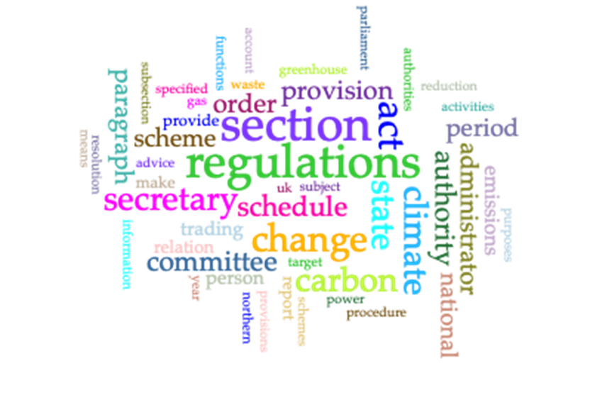
Text and document analysis
Climate Change Act 2008 word cloud
Commonly occurring terms:
Climate change: 323 times
Sustainable Development: 7 times
Sustainable: 17 times
Adaptation: 28 times
Local authorities: 11 times
Missing terms: city, urban area, mitigation
Greater emphasis on adaptation
No direct obligations impose to cities regarding climate change mitigation and adaptation

Slide 7
Initial common methodology
Selection of 30 cities in the UK with Climate Action Plans
Population, population growth, geographical position, socio-economic activities, coastal/inland, national recognition (if any)
Further selection of 6-8 UK cities for text analysis
Devolved administrations: Glasgow (Scotland), Cardiff (Wales), Belfast (Northern Ireland)
English cities: Manchester, Bristol, Nottingham, Leicester, Milton Keynes

Slide 8
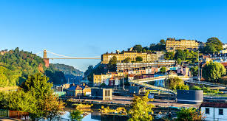
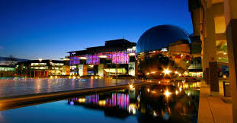
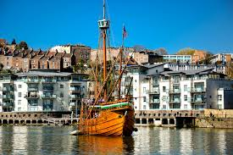
Case study 1: Bristol
Population: 457,609 inhabitants (medium size)
Population annual growth: +1.2%
Geographical position: Southwest / coastal
Economic activities: Maritime, modern IT and electronics industry, aerospace, tourism
European Green Capital 2015

Slide 9
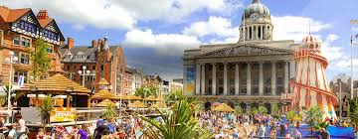
Case study 2: Nottingham
Population: 326,994 inhabitants (medium size)
Population annual growth: +1.4%
Geographical position: East Midlands (central) / inland
Economic activities: Science-based industry and service sector (main economic driver)
Social characteristics: High unemployment
UNESCO city of Literature

Slide 10
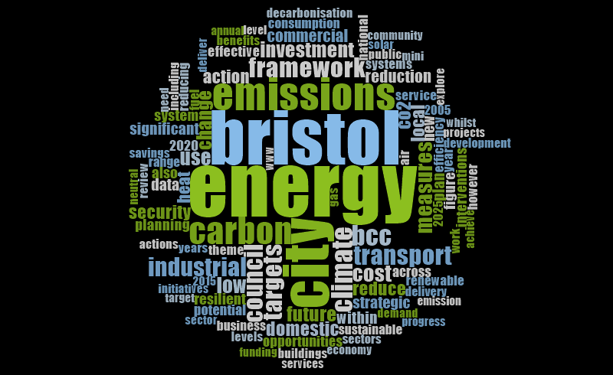
Initial DMU text analysis
Nottingham Community Climate Change strategy 2012-2020
(16,323 total words)
Bristol Our Resilience Future A Framework for Climate Change and Energy security
(21,949 total words)

Slide 11
Text analysis (word frequency) Comparison of selected cities
Bristol
Nottingham
industrial
schools
cost
energy
carbon
transport
heat
community
investment
people/residents
domestic
partnership
commercial
sustainable
resilient
behaviour

Slide 12
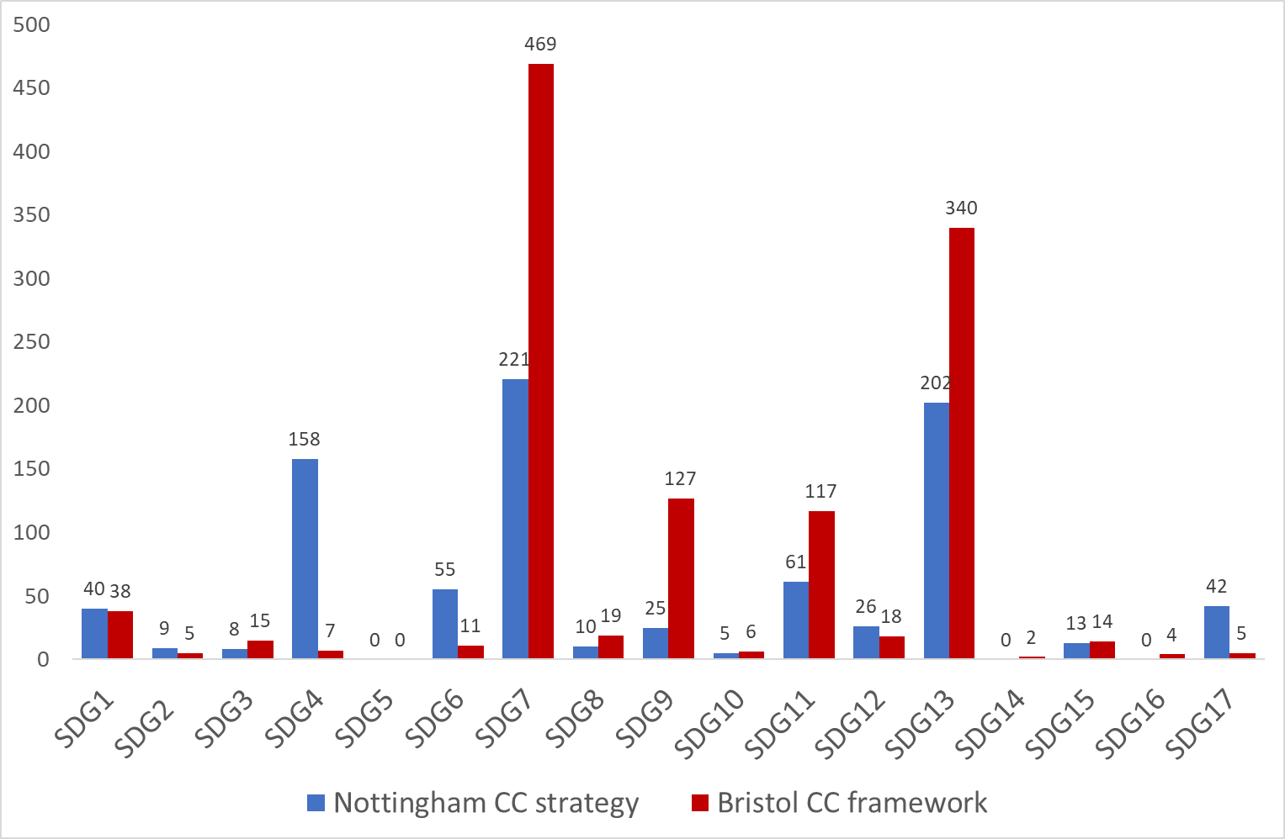
Initial DMU text analysis
Selection of 4-5 keywords for each SDG (DMU)
SDG7: Affordable and clean energy
Energy
Renewable
Energy efficiency
Solar
SDG13: Climate action
Adaptive
Flood
Impact
Carbon
Emissions

Slide 13
Text analysis (keywords) Comparison of selected cities
Bristol
Nottingham
SDG9 (industry and technology)
SDG4 (schools and skills)
SDG7
SDG13
SDG6 (water efficiency)
SDG11 (transport & housing)
SDG17 (partnerships)
SDG3 (health)
SDG1 (social / resilience)

Slide 14
Towards a common methodology
Further text analysis to be able to compare UK and Japanese cities
Selection of 10 keywords per each SDG (IGES)
Based on targets
Pros: More comprehensive and less subjective
Cons: 170 keywords, no interlinkages considered yet
For initial common analysis
Only focus on SDG13, SDG7 and SDG11
Only focus on Climate Action Plans
Complemented with interviews (if possible)

Slide 15
Nottingham (SDG keywords)

Slide 16
Nottingham (word tree) Example: waste (SDG11)
Energy from waste
(electricity and district heating)
Food and garden waste - compost

Slide 17
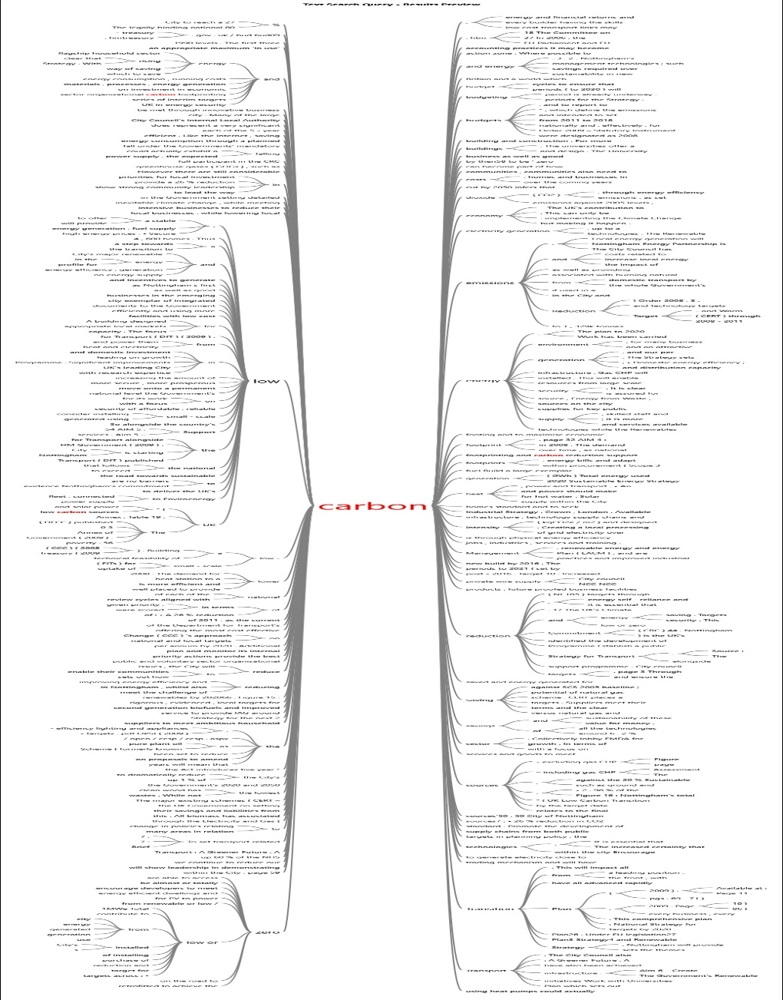
Nottingham (word tree) Example: carbon (SDG13)
SDG7:
Renewable energy
Energy efficiency
Affordable, reliable
Local generation infrastructure
SDG11:
Housing
Sustainable transport
SDG9:
Infrastructure, technology supply chains
Local businesses
SDG17:
Universities & voluntary sector

Slide 18
Nottingham (interview) Principal energy officer (29.08.2019)
Climate Action Plan (2010-2020)
Climate mitigation projects:
Low carbon heat (CHP and district heating), smart meters, solar PVs, social housing retrofit, low transport network, deployment of EV charging, tackling fuel poverty, etc.)
Climate adaptation projects:
Green and blue infrastructure (rainwater harvesting and water efficiency), SuDS, flood risk awareness
Work on SDGs:
SDG8: Increasing skills for renewable energy and retrofits through SMEs and housing providers, support to SMEs using Green Funds
SDG9: Projects related to the Energy Hub and Industry Strategy working with partners in the Midlands (for example related to energy storage using LEP funding, heat pumps and district heating)
Community projects (waste shops – reuse and recycle), local food (reducing food waste but also food miles)

Slide 19
Nottingham (interview) What is next?
Ambition: Become carbon neutral by 2028
Goal: Develop a co-benefits agenda
Achieving carbon targets considering SD
Co-benefit analysis of business cases and business models of carbon neutral projects
Interlinkages between different sectors (brining together agendas)
Protect and safeguard quality of life and well being of citizens + engagement with people
Main drivers: cost efficiency, fuel poverty reduction and bringing back revenue for further investment

Slide 20
SDG Mapping of climate actions
SDG 13
SDG 7: Energy
SDG 1: Poverty
SDG 3: Health
SDG 6: Water availability
SDG 12: Sustainable consumption and production
Ensure affordable, sustainable energy
50% reduction in poverty
Reduce premature deaths due to non-communicable diseases
Reduce waste generation by 50%

Slide 21
Next steps
Text analysis for 6-8 cities each in UK and Japan
Comparison and ranking of city plans
Some criteria to be developed
Mapping of SDG 13 onto other SDGs
Possibility of engaging with stakeholders and doing a ranking exercise
Possibility of modelling

Slide 22
Conclusions
Despite no direct obligations of cities in the 2008 Climate Change Act, LAs should report policies and progress towards national emissions reduction targets
City-level climate action plans differ considerably, with limited and indirect link to Sustainable Development
Climate actions can support the achievement of city-level SDGs
Better alignment could benefit local authorities and citizens

Slide 23
References
Bristol Green Capital Partnership (2018). Driving the Sustainable Development Goals Agenda at City level in Bristol, Bristol Green Capital Partnership, Bristol (https://bristolgreencapital.org/wp-content/uploads/2018/07/Bristol-Method_Driving-the-SDGs-agenda-at-city-level-in-Bristol_17-Jul-2018.pdf)
Leicester City Council (2014). Carbon Reduction Roadmap, Leicester.
Milton Keynes Council (2012). Milton Keynes Low Carbon Action Plan 2012, Buildings Control and Sustainability Team, Milton Keynes.
Nilsson M, Griggs D, Visbeck M (2016). Map the interactions of sustainable development goals. Nature 534:320–322. https://doi.org/10.1038/534320a

