Slide 1
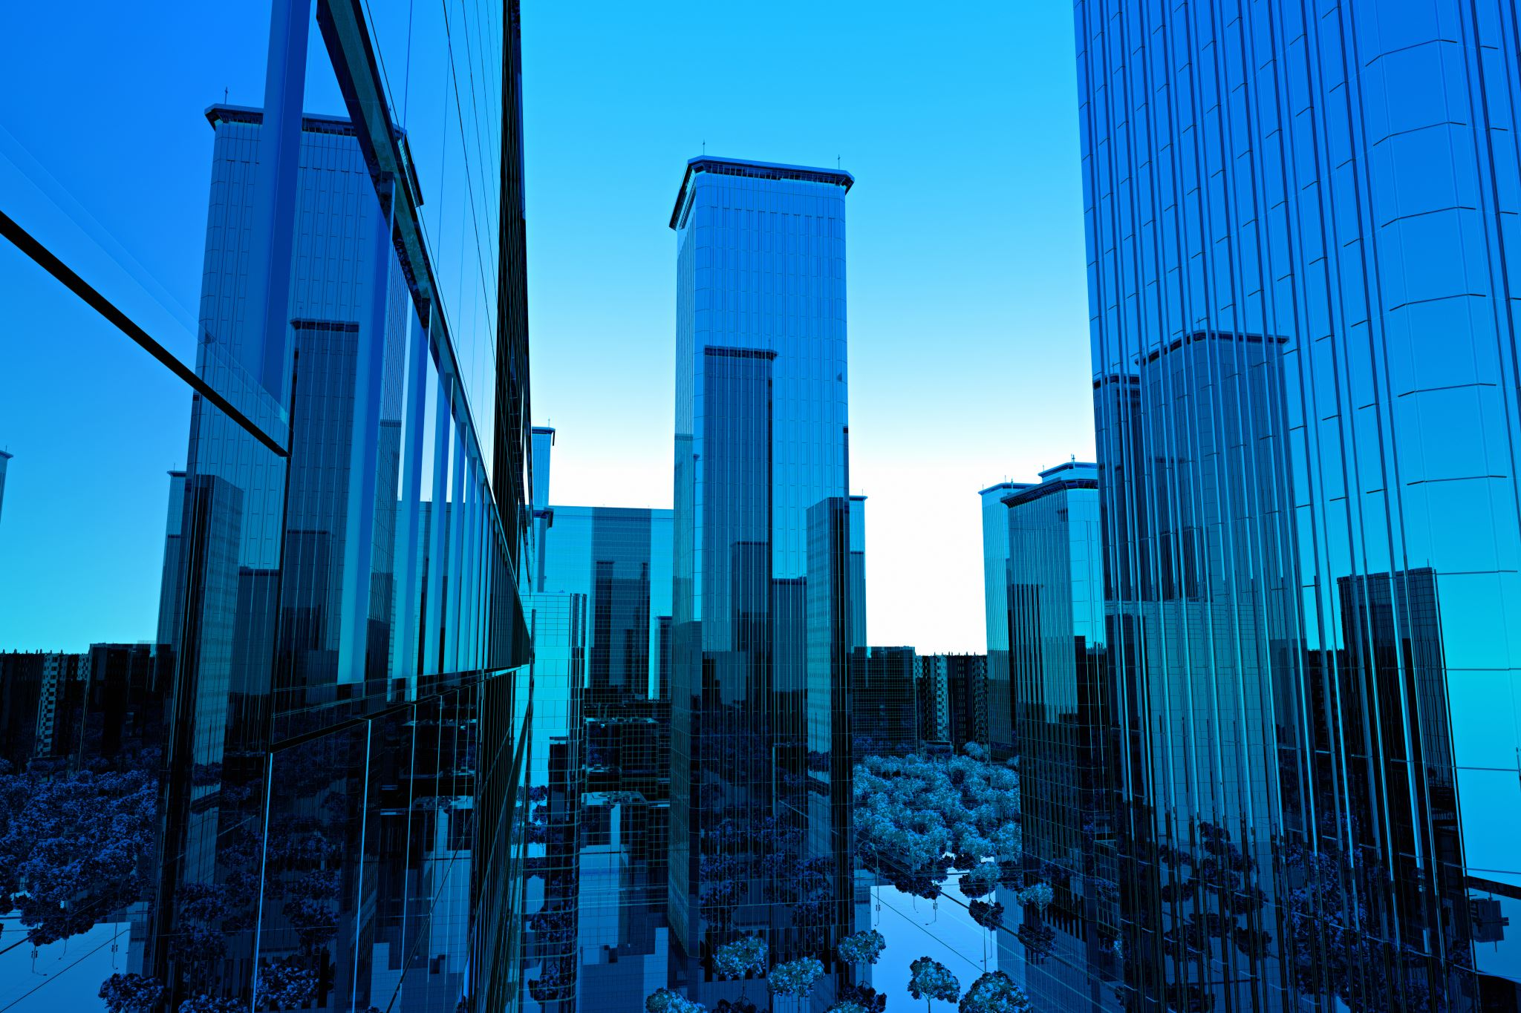
Role of research: Local climate actions and leaving no one behind
3rd February 2021,
UUK Climate Change Conference
Prof. Subhes Bhattacharyya
De Montfort University
Leicester, UK
subhesb@dmu.ac.uk

Slide 2
In this presentation
Local actions for climate change
SDGs and climate action alignment at local level
Role of Research

Slide 3
Urbanisation and climate change
By 2050, 1.2 million km² new urban built up area expected
80% of global GDP generated in cities
Cities consume 2/3rd of global energy
70% of global GHG emission come from cities

Slide 4
Crossing planetary boundaries and leaving many behind
GHG Emissions t/person/year; Ecological footprint- ha; water use 100 litres/person/day; death per 100,000/year;
Hoornweg et al., 2016, An urban approach to planetary boundaries, Ambio, 45(5):567-580.

Slide 5
Local climate actions
Business
Power transmission
Green homes
Agriculture
Electric vehicles
Resilient landscapes
Renewable power

Slide 6
Linkage with the SDGs
6, 7,13
Climate
8, 9, 11, 12
Cities
1, 2, 3, 4
Poverty
Energy
Jobs
Infrastructure
Water
Resource use
Hunger
Health
Education
Climate actions
Energy
Transport
Waste
Green homes
Green industries

Slide 7
Role of Research
Knowledge and skills
Local, global
Business
Research and development
Industry –business- University partnerships
Incubation and entrepreneurship
Research informed education
Training and community engagement
SME
Urban, Rural
Technology and innovation

Slide 8
Research agenda
Gap 1
SDG-decarbonisation integration
Synergies / trade-offs
Gap 2
Planning
Prioritisation
Gap 3
Governance
Reporting and feedback
Tool for support
Decision support systems
Governance realignment

