Slide 1
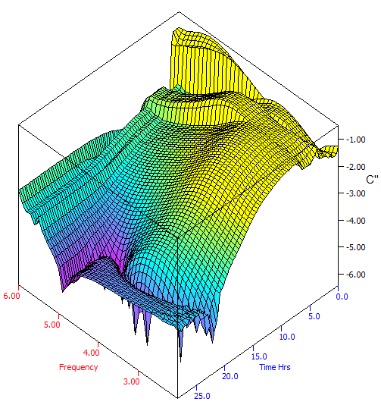
Lyosense™. Lyophilization process control
G. Smith¹, E. Polygalov¹, T. Page²
¹School of Pharmacy, De Montfort University, Leicester, LE1 9BH, UK.
²GEA Pharma Systems, School Lane, Chandlers Ford, Eastleigh, SO53 4DG
INTRODUCTION
State-of-the art freeze-drying process control is limited to: the measurement of pressure (to monitor the duration of primary drying in which ice is removed directly to vapour); the control of the shelf coolant temperature; and the occasional in-vial temperature measurement (to measure the onset of ice formation) [1]. However, pressure measurements provide only the average drying time of the whole batch and individual vial data is inaccessible. Moreover, the inclusion of the “in-vial” sensor impacts both the on-set temperature (one is trying to measure) and the structure of ice (which in turn impacts the drying time). More recent attempts to develop on-invasive methods for measuring individual vial drying times have been proposed. However, these necessitate the application of a mathematical function to the measurement of some in-line physical parameter (e.g. external vial temperature), a process which is non-trivial [2].
The aim of this work is to develop an individual vial monitoring system (Lyosense™) for characterizing lyophile product characteristics and process end points to establish and control lyophilization regimes.
LyosenseTM is a process analytical technology based on dielectric analysis of the lyophilization process. The system measures the pseudo-relaxation process associated with the interfacial polarization of the glass wall, through the resistance of the sample. This process undergoes characteristic changes in amplitude and peak frequency, such that the progress of freeze-drying and condition of the sample can be controlled.
Materials and Methods
Lyosense™ comprises a modified glass freeze-drying vial, with an electrode system deposited on the external surface, coupled to a high precision impedance analyser via miniature coaxial connectors, which are surface mounted at the neck of the vial. The thermal mass of the vial-electrode-connector-system is <0.5% of the mass of the vial/product. The current system has 5 channels, which connect to 5 individual vials positioned around the freeze-drier shelf.
Fig.1 Dielectric permittivity and loss spectra of lactose 3% w/v during the process of freeze-drying. (A) Solution phase; (B) frozen; (C) Annealing phase; (D) Primary drying; (E) Secondary drying.
Fig. 2 Log peak frequency (A) and peak amplitude (B) throughout a typical freeze-drying cycle of sucrose 5%w/v. Stages I to III are the freezing stage, primary drying, and secondary drying respectively.
Fig.3 Peak amplitude derivative and throughout the primary drying phase. The maxima observed for the central vial (C) and the right/front vial (Rf) demonstrate that the ice front in these vials has receded through the depth of the material, and subsequent switching to secondary drying may be undertaken without risking collapse of the product.
Frequency scans of the system impedance were recorded during a range of freeze-drying cycles and placebo formulations. By varying the salt loading it was possible to simulate the impact of drug loading on the electrical conductivity of lyophile products. This is a critical parameter in the function of the Lyosense™ system, as it defines the limiting values of the peak frequency (from the high frequency limit in the non-frozen state to the low frequency limit in the frozen state).
RESULTS AND Discussion
Changes in phase (e.g. ice formation) and completion of freezing, the onset of micro-collapse, and the end-points of primary and secondary drying are all detected by this method through changes in the measured impedance of the vial-electrode assembly.
These transitions are more easily determined if the impedance is displayed as a complex capacitance or dielectric permittivity, where the cell constant is presumed to equal 1.
The imaginary capacitance (C″, dielectric loss) is characterized by a peak in the frequency spectrum (Figure 1) which arises from the composite capacitor of the product in series with the glass vial. It has been demonstrated, in general, that the frequency of the peak is strongly coupled to the temperature of the product (through the interdependency of product temperature and/or phase on the electrical resistance of the product) whereas the height of the peak is dependent on the amount of ice remaining (in primary drying) and the residual surface moisture (in secondary drying).
As the cycle progresses the peak height decreases (Figure 2B) with a characteristic sigmoid time-dependence (Figure 3) such that the derivative of the time-profile can be used to define the end of the primary drying.
CONCLUSIONS
In-process control may be established using the Lyosense™ system, through the definition of set-points (i.e. the product temperature during primary drying, to drive the process at a high temperature while avoiding collapse) and end points (to establish the moisture content of the product).
ACKNOWLEDGMENTS
The Technology Strategy Board for co-funding this work through the High Value Manufacturing Collaborative R&D programme.
REFERENCES
[1] T.A. Jennings. Lyophilization, 1999, InterPharm Press, Denver; p.615-617
[2] A.A. Barresi et al. “In-line control of the lyophilization process. Gentle PAT approach using software sensors” Int. J. Refridgeration 32 (2009) 1003-1014
I
A
B
II
C
D
III
E
I
A
B
II
C
D
III
E
1
5
4
Left rear (L_{r})
Centre
Right rear (R_{r})
2
3
Left front (L_{f})
Right front (R_{f})
Inlet
Outlet

