Slide 1
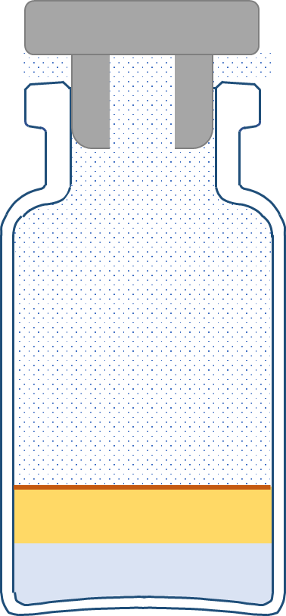
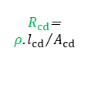

[A]
[B]
$$R_{p}=\frac{R_{ss}\left(R_{cs}+R_{cd}\right)}{R_{ss}+\left(R_{cs}+R_{cd}\right)}$$
$R_{p}$/ms⁻¹
$$R_{c}=R_{cs}+{ρ.l_{cd}}/{A_{cd}}$$
$R_{ss}=11.4×{10}^{4}$ ms⁻¹
$$R_{cs}$$
Deconstruction
of the ‘dry’ layer
into a skin over
the top of
a shunt pathway
surrounding
a core dry layer
$R_{cs}=1.74×{10}^{4}$ ms⁻¹
Total product resistance, $R_{p}$
$$R_{ss}$$
Total skin resistance, $R_{s}$
$$R_{cd}$$
$R_{s}=R_{p}(l_{cd}=0)=\frac{R_{ss}R_{cs}}{R_{ss}+R_{cs}} =1.51×{10}^{4}$ ms⁻¹
Vapour flow
(shunt) (core)
$l_{cd}$/10⁻³ m
$$P_{c}$$
$$R_{st}$$
$$P_{v}$$
Skin (s)
$$A_{s}$$
$$R_{s}$$
$$R_{ss}$$
$$A_{ss}$$
[C]
shunt skin (ss)
core skin (cs)
$$A_{cs}$$
$$R_{cs}$$
Core dry-layer (cd)
(shrunken)
$R_{cd}$=
$${ρ.l_{cd}}/{A_{cd}}$$
$$l_{cd}$$
vapour
Ice layer
$$P_{v}$$
Shunt, i.e., by-pass
of the core dry-layer,
presents zero resistance
to vapour flow
and so is ignored
$$R_{p}$$
‘dry’ layer
$$l_{cd}$$
$$A_{cd}$$
$$P_{i}(T_{i})$$
Ice layer
$$P_{i}\left(T_{i}\right)$$
Vapour pressure at the ice interface of temperature,
$$P_{v}$$
Vapour pressure inside the vial
$$R_{p}$$
$$T_{i}$$
Product resistance
$$P_{c}$$
Vapour pressure in drying chamber
$$R_{st}$$
Stopper resistance
$$ρ$$
Resistivity of the core dry layer (6.6 x 10³) (m/s).mm

