Slide 1
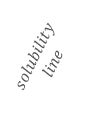
T/°C
80
100% sucrose
(amorphous )
60
Solution (unsaturated)
$$solubility$$
$$line$$
40
Crystallised or
rubbery, super-
saturated
solution
$$T_{g}\text{(}\text{onset}) 62 °C$$
$5\% w/w$
@ 20 $°$C
$$solubiliy of sucrose$$
$\text{@ 20 }°\text{C}$ =$67\% w/w$
$$T_{m}$$
$$0 °C$$
20
0
Slow cooling
Super-cooling
ice
nucleation
$$T_{c}$$
Freezing
Point
depression
−20
Ice and solution
(partially freeze-concentrated)
$$T_{m}^{′}$$
$$−34 °C$$
− 40
Maximum ice formation
$$T_{g}^{′}$$
$$−46 °C$$
− 60
Ice and (rubbery or glassy) solution
− 80
Maximally
Freeze-
concentrated
solution
− 100
ultra-fast
cooling
ice formation
supressed
Glass
(no ice)
− 120
$$C_{g}^{′}$$
$$80\%w/w$$
$$T_{g}$$
$$−135 °C$$
− 140
vitrification
100% water
(amorphous)
0
10
20
30
40
50
60
70
80
90
100
% w/w sucrose
The phase diagram for the sucrose-water system. The starting point shown by the red dot and the arrows that follow the phase boundary indicates the freezing path of a solution containing 5 % sucrose when frozen at rates typical of a freeze-dryer (0.5 to 1 °C min⁻¹). The alternative route shown by the vertical dotted line is the freezing path when ultra-fast cooling to provided. Then the degree of supercooling takes the product below the glass transition of the 5% w/w solution and results in no ice but a purely amorphous, glassy solid.

Slide 2
Maximum width of figure for book chapter format is 13 cm

Slide 3
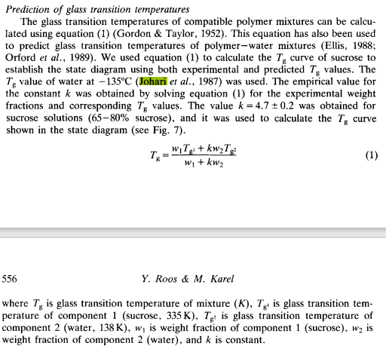
Maximum width of figure for book chapter format is 13 cm
Fig. 7 from Roos 1991
The glass transition curve (in blue) is generated from the Gordon Taylor equation (eqn 1) with values for the glass transitions 100% (dry) amorphous sucrose and 100% amorphous water of – 6 °C and – 135 °C taken from Roos and Karel (1991) and Johari et al., 1987, respectively
(Johari, G.P., Hallbrucker, A. & Mayer, E. (1987). The glass-liquid transition of hyper-quenched water. Nature, 330, 552-553)
The symbol ′ (i.e., prime) is used to indicate the maximally concentrated solution that is obtained on slow freezing; which has a concentration of 80% w/w sucrose and a glass transition at $−$46 °C. The melting point of ice, if it where kinetically possible to form would be $−$34 ° C Bellows & King (1973)

Slide 4
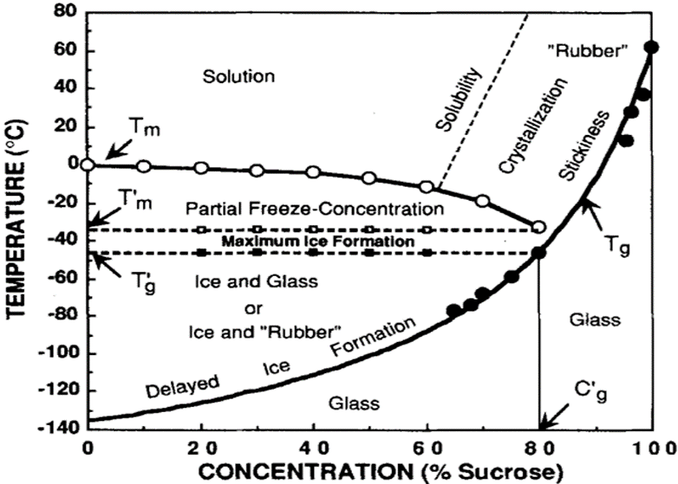
Original from Roos 1991
https://onlinelibrary.wiley.com/doi/abs/10.1111/j.1365-2621.1991.tb08029.x

