Slide 1
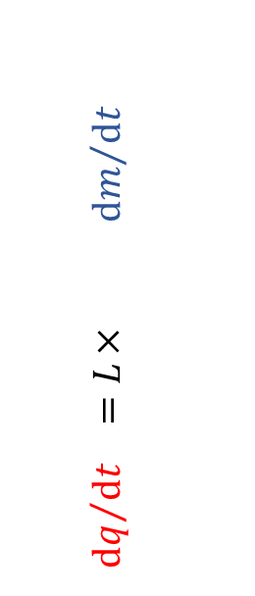
condenser
$$P_{ice(condenser)}=0.5 to 3 μbar$$
$$T_{ice(condenser)}=−70 to −80 °C$$
vapour flow resistance
Driving force for sublimation
$$R_{duct}$$
$${dm}/{dt}=\frac{A_{i}\left({vP}_{ice}−{vP}_{chamber}\right)}{ (R_{dry}+R_{skin}+R_{stopper})}$$
duct
$$R_{stopper}$$
Stopper
Assumes that the chamber is saturated with vapour
$$R_{stopper}$$
$${vP}_{chamber} =P_{total}$$
vent
Measured by capacitance manometer
$${vP}_{ice}$$
$$T_{ice(interface)}$$
Mass transfer (sublimation)
Estimated from or vice versa,
e.g., @ −35 °C ${vP}_{ice}$ = ??? $μbar$ / Pa / mTorr
$${vP}_{vial}$$
Temperature (T ) °C
Radiation
−35
−30
−25
−15
−10
−5
$${dq}/{dt} =L{× dm}/{dt}$$
$$R_{skin}$$
Heating
Skin
$$T_{dry(surface)}$$
10
$$R_{dry}\left(t\right)$$
Dry layer
$$T_{ice(interface)}$$
Sublimation
interface
Distance from shelf surface (mm)
$$A_{i}$$
Cooling from latent heat of sublimation maintains $T_{ice(interface)}below$ $T_{c}$
5
$$K_{ice}\left(t\right)$$
Thermocouple
position
Heat transfer
Frozen layer
$$T_{ice(base)}$$
Heating
0
$$K_{v}$$
glass
$$A_{v}$$
$$T_{shelf(surface)}$$
Shelf
$$T_{c}$$
(critical temperature)
Heat transfer coefficient
Shelf
to
glass
‘Measurable’ driving
force for heating
Mainly gas convection/conduction
Limited “contact” conduction
Model developed
by Pikal and Shah (1984)
$${dq}/{dt}=A_{v}.K_{v}\left(−{ T}_{ice(base)}+T_{shelf\left(surface\right)}\right)$$

